Slide 1







Security on AWS – Part 2

Slide 2
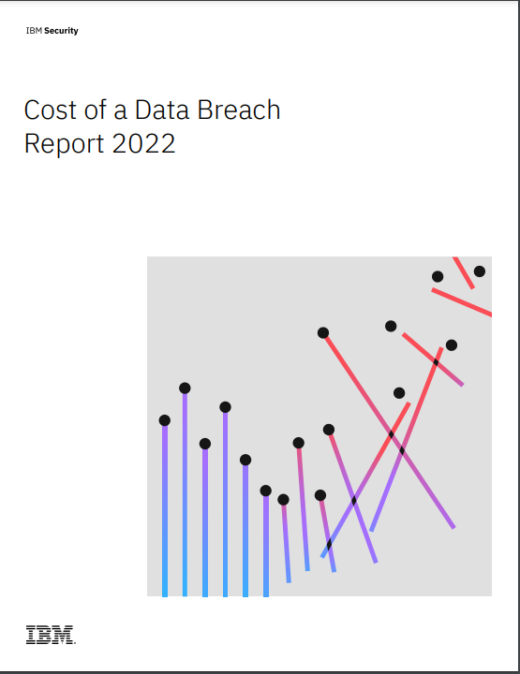

Cost of a Data Breach Report 2022 – By IBM Security
Average Time to identify a Security breach?
207 Days
Average Time to contain a breach?
70 Days
Average time to identify and contain a data breach
277 Days
Notes:
https://www.ibm.com/downloads/cas/3R8N1DZJ
In 2022 it took an average of 207 days to identify the breach and 70 days to contain the breach.

Slide 3

AWS Security Services

Slide 4


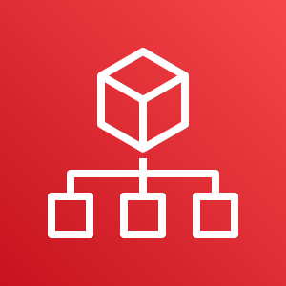







































AWS Foundational and Layered Security Services
AWS
Security
Hub
AWS
Organizations
AWS Transit Gateway
Amazon
VPC
AWS IoT Device Defender
Amazon Cloud Directory
Amazon GuardDuty
Amazon CloudWatch
AWS Step
Functions
AWS
OpsWorks
AWS Control Tower
AWS Trusted Advisor
Amazon VPC PrivateLink
AWS
Direct Connect
Resource Access manager
AWS Directory Service
Amazon Inspector
AWS Systems Manager
AWS Lambda
AWS CloudFormation
Automate
Identify
Protect
Detect
Respond
Recover
Investigate
AWS Service Catalog
AWS Config
AWS Shield
IAM
AWS Secrets Manager
KMS
Amazon Cognito
Amazon Macie
Amazon CloudWatch
AWS CloudTrail
Amazon S3
Glacier
Amazon Detective
AWS Well-Architected Tool
AWS
Systems Manager
AWS WAF
AWS Firewall Manager
AWS Certificate Manager
AWS CloudHSM
AWS IAM Identity Center
AWS
Security Hub
Snapshot
Archive
Personal Health Dashboard
Amazon
Route 53

Slide 5

Identify

Slide 6
AWS Foundational and Layered Security Services
AWS
Security
Hub
AWS
Organizations
AWS Transit Gateway
Amazon
VPC
AWS IoT Device Defender
Amazon Cloud Directory
Amazon GuardDuty
Amazon CloudWatch
AWS Step
Functions
AWS
OpsWorks
AWS Control Tower
AWS Trusted Advisor
Amazon VPC PrivateLink
AWS
Direct Connect
Resource Access manager
AWS Directory Service
Amazon Inspector
AWS Systems Manager
AWS Lambda
AWS CloudFormation
Automate
Identify
Protect
Detect
Respond
Recover
Investigate
AWS Service Catalog
AWS Config
AWS Shield
IAM
AWS Secrets Manager
KMS
Amazon Cognito
Amazon Macie
Amazon CloudWatch
AWS CloudTrail
Amazon S3
Glacier
Amazon Detective
AWS Well-Architected Tool
AWS
Systems Manager
AWS WAF
AWS Firewall Manager
AWS Certificate Manager
AWS CloudHSM
AWS IAM Identity Center
AWS
Security Hub
Snapshot
Archive
Personal Health Dashboard
Amazon
Route 53

Slide 7

AWS Organizations

Slide 8








Why multiple accounts?
Governance
Security Policies
Blast Radius
Account limits
Operational Boundary
Cost Visibility
Support Plan

Slide 9
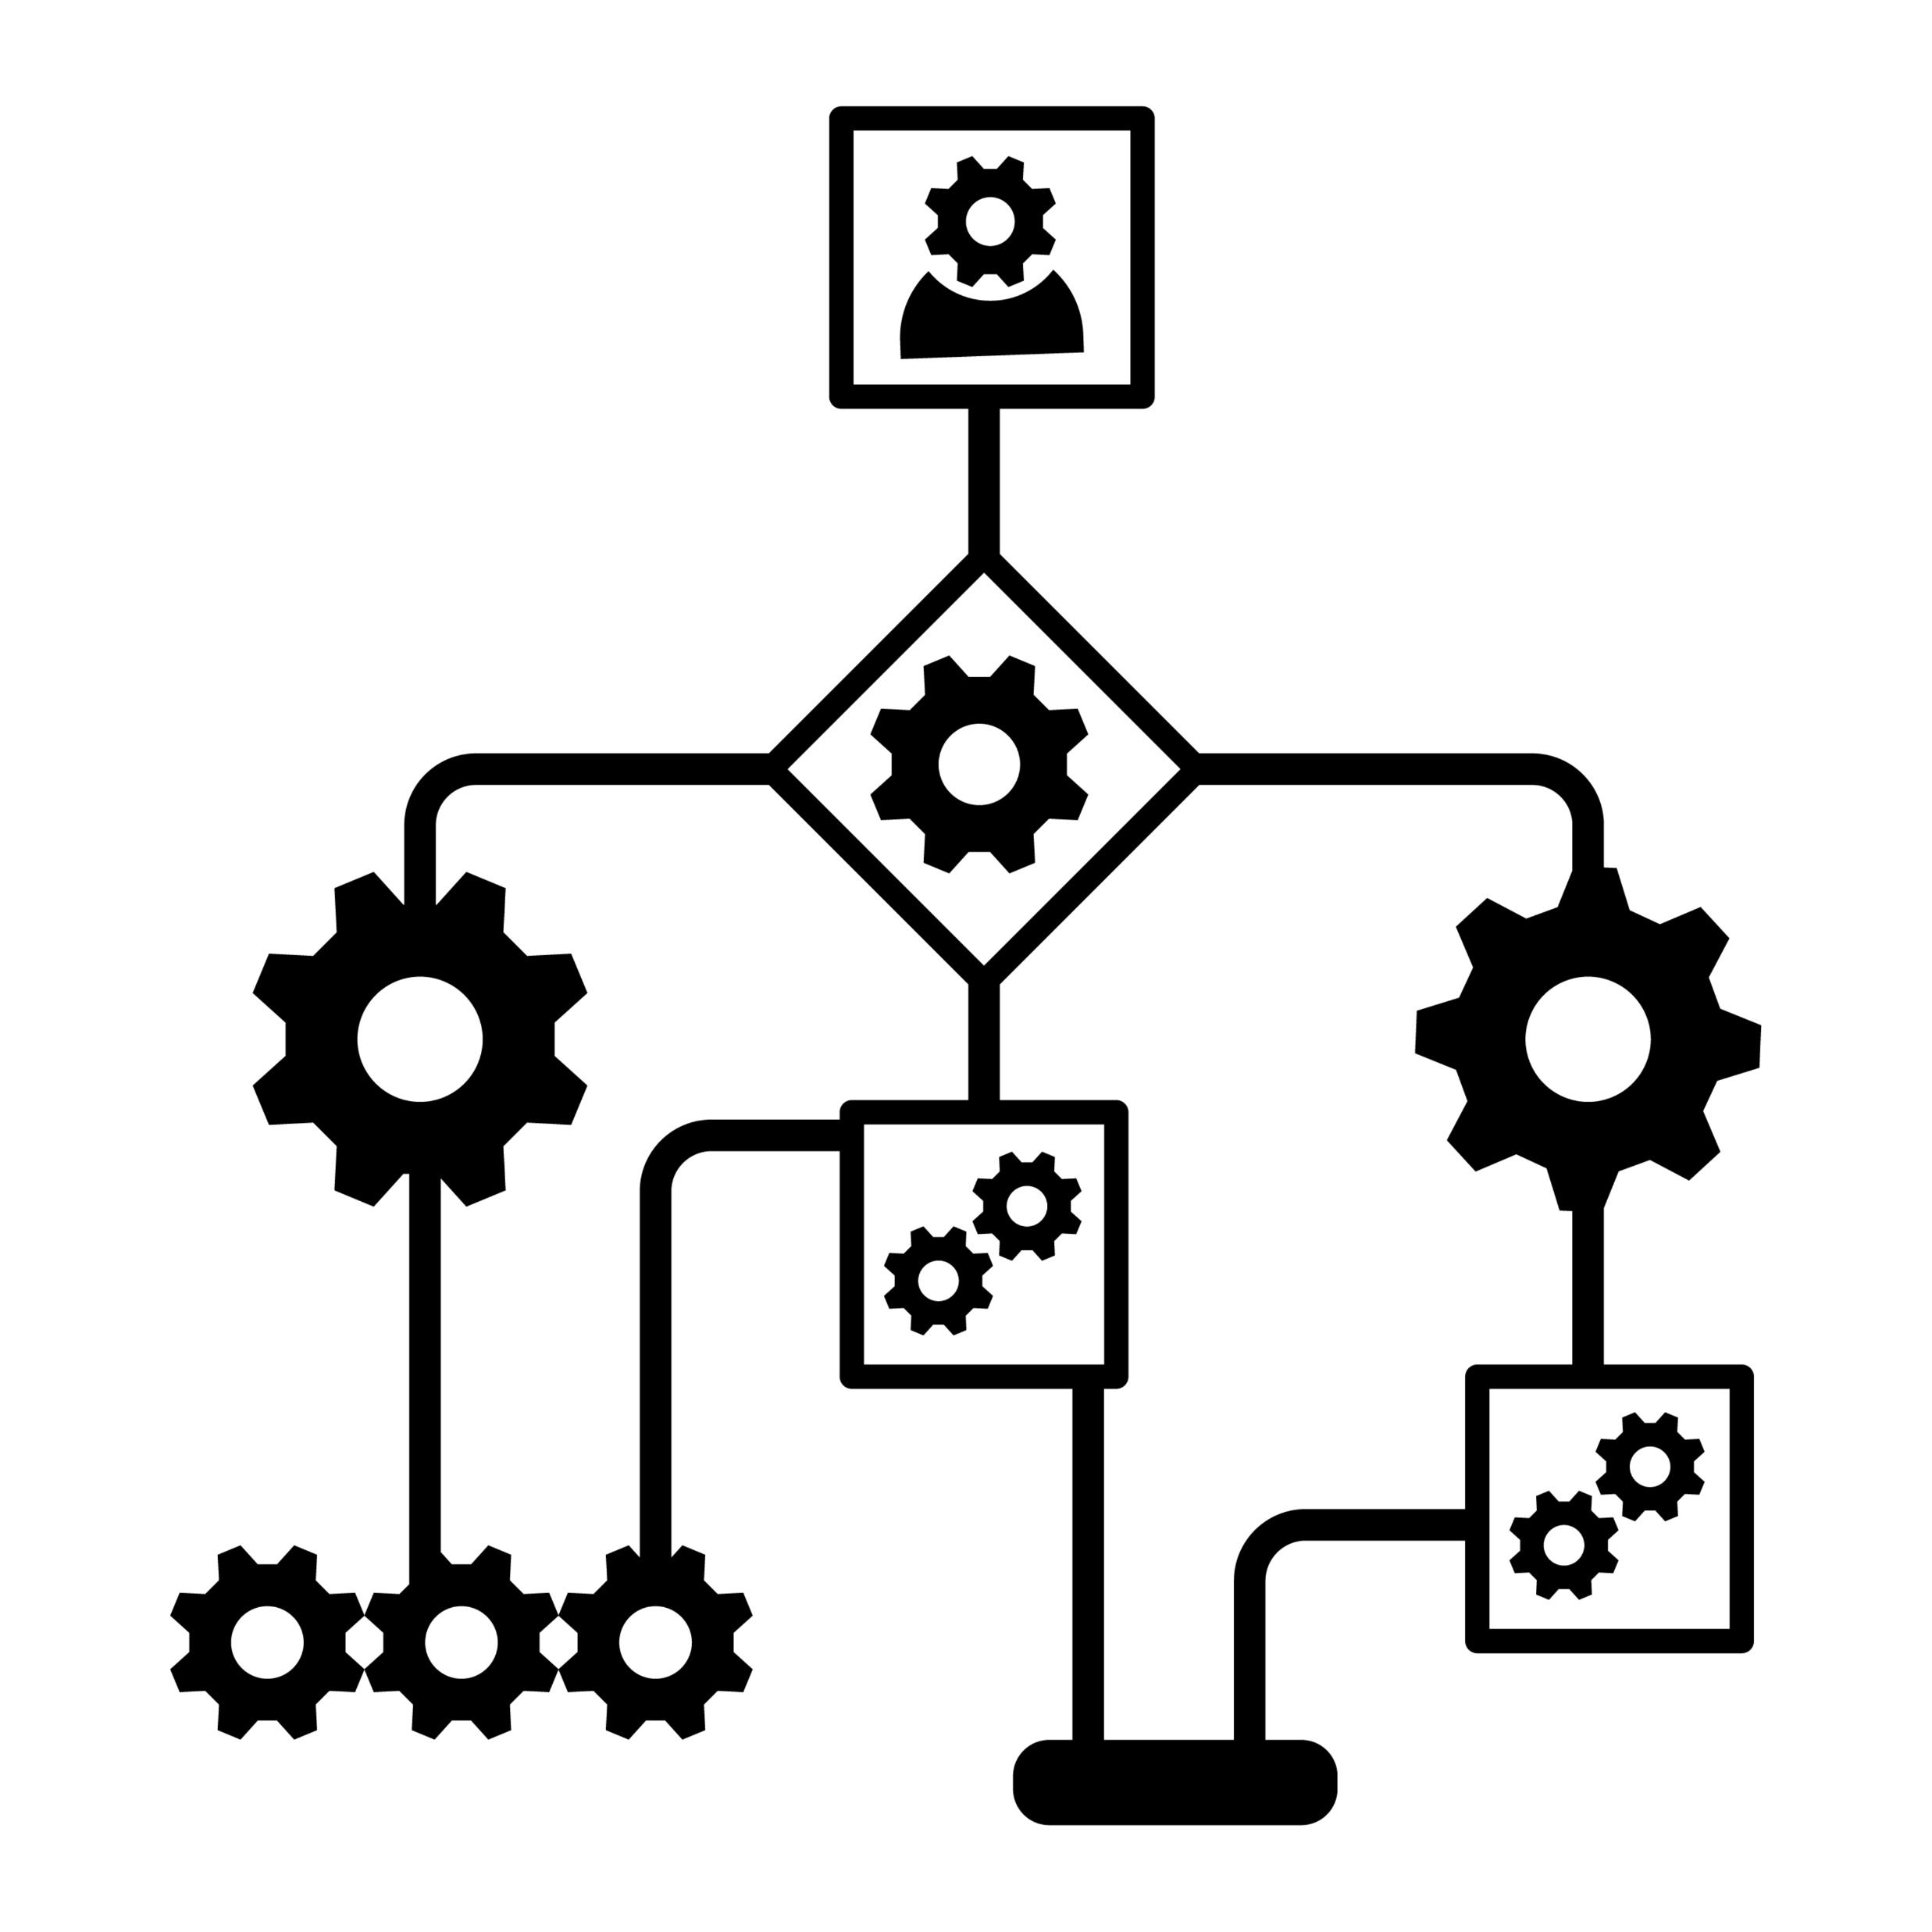


Challenges in Multi Account AWS Environment
Operational Overhead
Individual Billing
Security Control

Slide 10
AWS Organizations

Slide 11


























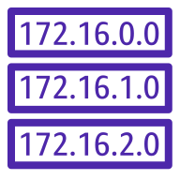











AWS Organization
S
C
P
1
Attach
Create AWS Organization
Create Organization Units (OUs)
Attach Service Control Policy (SCPs)
Add / Invite member AWS Accounts
Root
Management Account
AWS Account 1
27229163910
S
C
P
2
Attach
Dev
OU
QA
OU
Prod
OU
S
C
P
3
Attach
Member Account
Member Account
Member Account
PCI
OU
HIPPA
OU
AWS Account 2
536319031239
SCP1
SCP2
AWS Account 3
182367136291
SCP1
AWS Account 4
826204816391
AWS Resources
AWS Resources
AWS Resources
Member Account
Member Account
SCP1
AWS Account 5
349908346261
SCP1
SCP3
AWS Account 6
561783987245
AWS Resources
AWS Resources

Slide 12
SCP Examples
Allow example
Deny example
{
"Version":"2012-10-17",
"Statement":[
{
"Effect":"Allow",
"Action":[
"EC2:*","S3:*”
],
"Resource":"*"
}
]
}
{
"Version":"2012-10-17",
"Statement":[
{
"Effect":”Deny",
"Action":[
”SQS:*”
],
"Resource":"*"
}
]
}

Slide 13




Effective Permission
SCP
IAM
Allow: EC2:*
Allow: EC2:*
Allow: S3:*
Allow: SQS:*

Slide 14
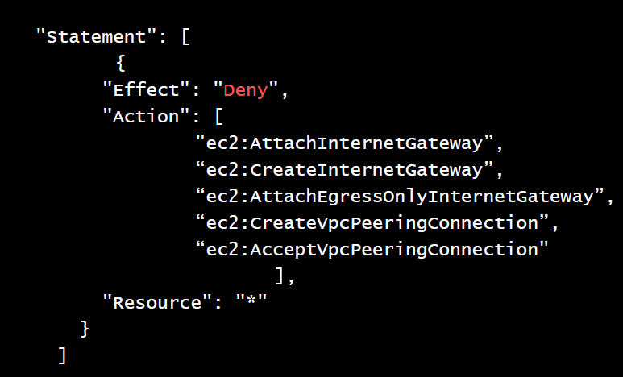
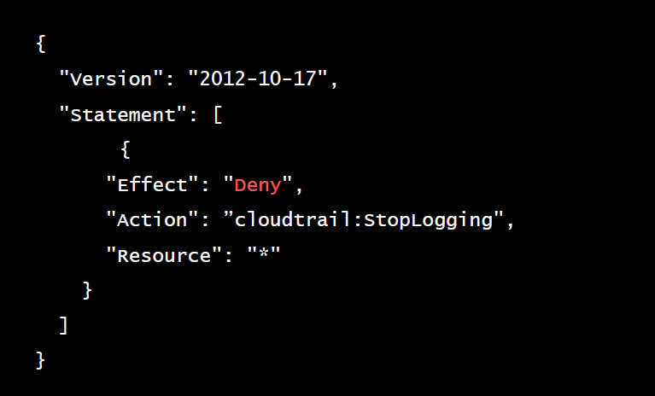
SCP Examples
No Internet Gateway for VPC
Stop CloudTrail from being disabled
More Example service control policies

Slide 15

AWS Control Tower

Slide 16








Can you design an airport?

Slide 17

Where to start?

Slide 18

Lets use the best practices from other successful airport designs

Slide 19
Setting up a new AWS Multi-account architecture
Initial Setup
Create Organization Management account
Create temporary Amazon S3 bucket of AWS CloudTrail logs
Enable CloudTrail locally
Enable AWS Organization full feature
Create Log Archive account
Create bucket(s) for security logs
Create Security account
Create Roles – Read Only | Power Users | Admin
Create a Shared Services Account
Configure Single Sign-On (SSO)
Repeat setup for every account
Secure Root credentials
Complex password policy
Link to Organization Master account
Enable CloudTrail
Send Log to Archive account
Enable Amazon GuardDuty
Enable AWS Config
Enable appropriate Config rules
Amazon S3 bucket encryption
Amazon S3 block public access
EBS Volume encryption
Etc…
Create common cross-account Security role
Read Only | Power User | Admin
Create VPC (non-overlapping IP space)
Enable federation into account (SSO)
Etc..

Slide 20
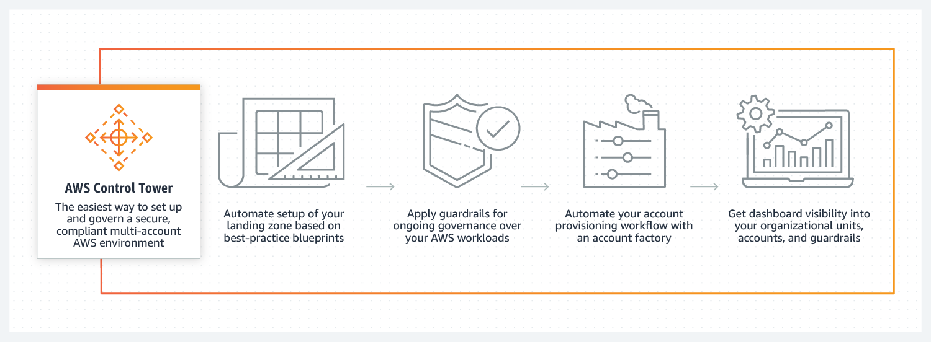
AWS Control Tower
AWS Control Tower provides the easiest way to set up and govern a secure, compliant, multi-account AWS environment based on best practices established by working with thousands of enterprises.

Slide 21









AWS Control Tower
Landing zone
Guardrails
Account Factory
Dashboard

Slide 22
AWS Control Tower – Landing Zone
Landing zone
A well-architected, multi-account AWS environment based on security and compliance best practices.

Slide 23
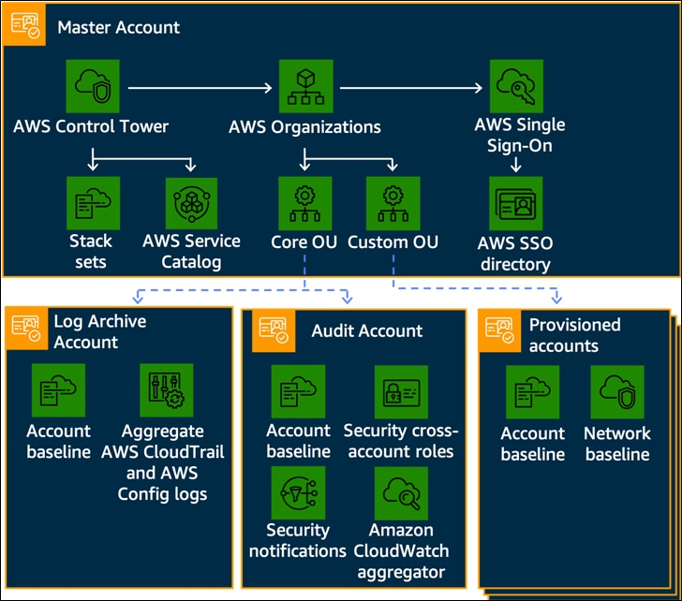
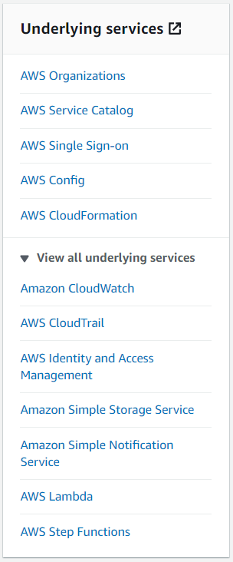
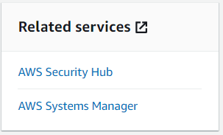

Landing Zone Structure
Management Account
No additional charge exists for using AWS Control Tower.

Slide 24
AWS Control Tower - Guardrails
Landing zone
A well-architected, multi-account AWS environment based on security and compliance best practices.
Guardrails
A high-level rule that provides ongoing governance for your overall AWS environment.

Slide 25
AWS Control Tower – Account Factory
Landing zone
A well-architected, multi-account AWS environment based on security and compliance best practices.
Guardrails
A high-level rule that provides ongoing governance for your overall AWS environment.
Account Factory
A configurable account template that helps provisioning of new AWS accounts with pre-approved account configurations.

Slide 26
AWS Control Tower
Landing zone
A well-architected, multi-account AWS environment based on security and compliance best practices.
Guardrails
A high-level rule that provides ongoing governance for your overall AWS environment.
Account Factory
A configurable account template that helps provisioning of new AWS accounts with pre-approved account configurations.
Dashboard
Offers continuous oversight of your landing zone to your team of central cloud administrators.

Slide 27

Protect

Slide 28
AWS Foundational and Layered Security Services
AWS
Security
Hub
AWS
Organizations
AWS Transit Gateway
Amazon
VPC
AWS IoT Device Defender
Amazon Cloud Directory
Amazon GuardDuty
Amazon CloudWatch
AWS Step
Functions
AWS
OpsWorks
AWS Control Tower
AWS Trusted Advisor
Amazon VPC PrivateLink
AWS
Direct Connect
Resource Access manager
AWS Directory Service
Amazon Inspector
AWS Systems Manager
AWS Lambda
AWS CloudFormation
Automate
Identify
Protect
Detect
Respond
Recover
Investigate
AWS Service Catalog
AWS Config
AWS Shield
IAM
AWS Secrets Manager
KMS
Amazon Cognito
Amazon Macie
Amazon CloudWatch
AWS CloudTrail
Amazon S3
Glacier
Amazon Detective
AWS Well-Architected Tool
AWS
Systems Manager
AWS WAF
AWS Firewall Manager
AWS Certificate Manager
AWS CloudHSM
AWS IAM Identity Center
AWS
Security Hub
Snapshot
Archive
Personal Health Dashboard
Amazon
Route 53

Slide 29

Protect your application
Encryption
AWS Certificate Manager
AWS Key Management Service
AWS CloudHSM
Mitigation of DDoS attacks
AWS Web Application Firewall (WAF)
AWS Shield
AWS Firewall Manager
Authentication & Authorization
AWS Directory Service
Amazon Cognito
AWS Identity and access management (IAM)
AWS Identity Center (AWS Single Sign-On)

Slide 30

Encryption Basics

Slide 31

What is this?
Encrypted Message
Scytale
Key
Notes:
https://en.wikipedia.org/wiki/Scytale

Slide 32
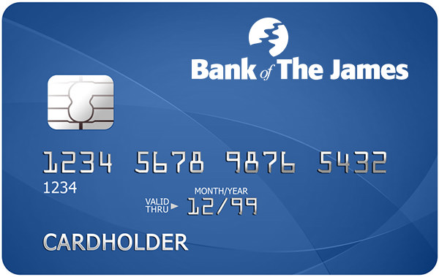
Encryption Analogy
Pin
4 5 8 2
Key
+ 1 - 1
4 5 8 2 (Plain Text)
+ 1
-1
+ 1
- 1
5 4 9 1
Decrypt
Cypher Text
5 4 9 1
5 4 9 1
+ <Value> - <Value>
Algorithm
Key
+ 1 - 1
- 1
+1
- 1
+1
4 5 8 2
Value = 1
Key Material

Slide 33

Encryption in AWS

Slide 34










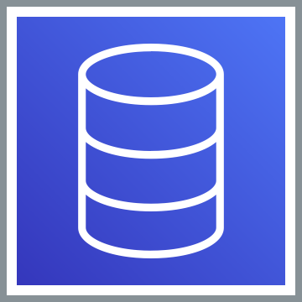








Encryption in Transit / Encryption at Rest
AWS Cloud
Entry Point
Frontend / Processing
Storage
Internet
ELB
EC2
S3
Glacier
Encryption
in Transit
Users
SSL/TLS
Certificate
Databases
DynamoDB
API GW
Containers
CloudFront
Lambda
EFS
FSx
Encryption
in Transit
Encryption
at Rest
SSL/TLS
Certificate
AWS Certificate Manager
Encryption
Key
AWS Key
Management Service

Slide 35
AWS Certificate Manager

Slide 36




AWS Certificate Manager
Easily provision, manage, and deploy public and private SSL/TLS certificate
AWS Certificate Manager supports a growing number of AWS services.
Private
Provision, Manage & Renew Certificates
Private Certificate Authority (CA)
Free for ACM integrated services
Import 3rd Party Certificates
Notes:
Removes the time-consuming manual process of purchasing, uploading, and renewing SSL/TLS certificates.
It also enables you to create private certificates for your internal resources and manage the certificate lifecycle centrally.
https://aws.amazon.com/certificate-manager/private-certificate-authority/
AWS Certificate Manager for use with ACM-integrated services are free.
https://docs.aws.amazon.com/acm/latest/userguide/acm-services.html
Makes it easy to import SSL/TLS certificates issued by third-party Certificate Authorities (CAs).
https://docs.aws.amazon.com/acm/latest/userguide/acm-services.html

Slide 37
AWS Key Management Service (KMS)

Slide 38
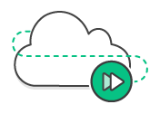

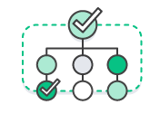

AWS Key Management Service
Easily create and control the keys used to encrypt or digitally sign your data.
AWS KMS service stores key material on a device called HSM (Hardware Security Module).
Fully
managed
Built-in
auditing
Compliant with
PCI, HIPAA and more
Supports Custom Key Store

Slide 39
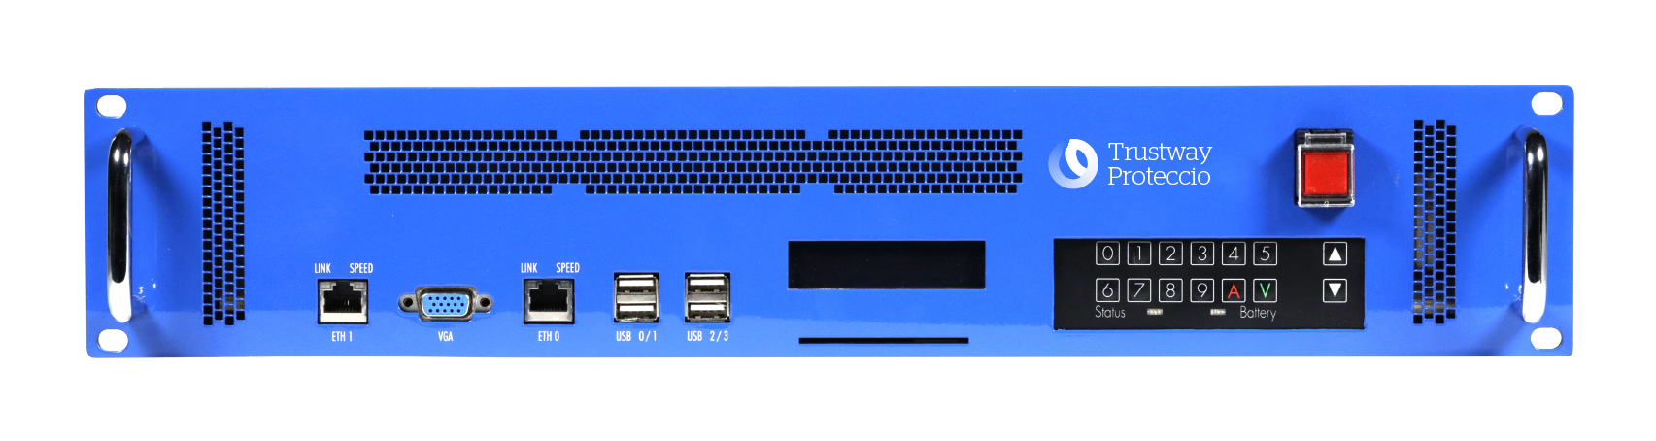
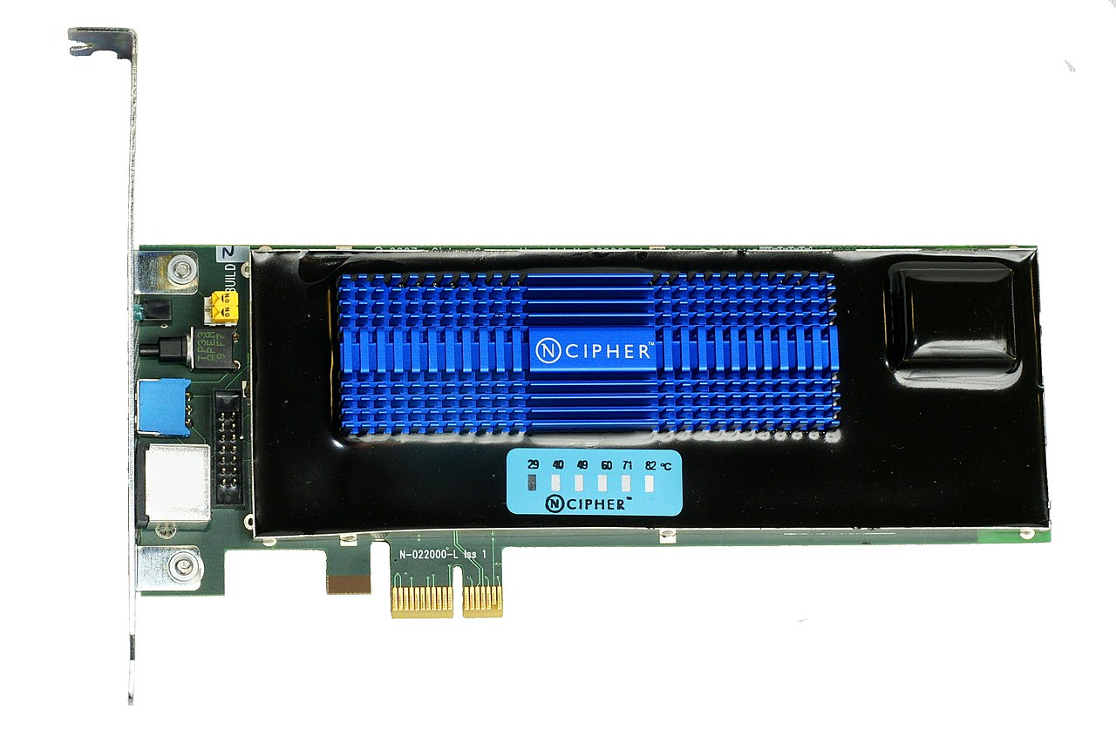
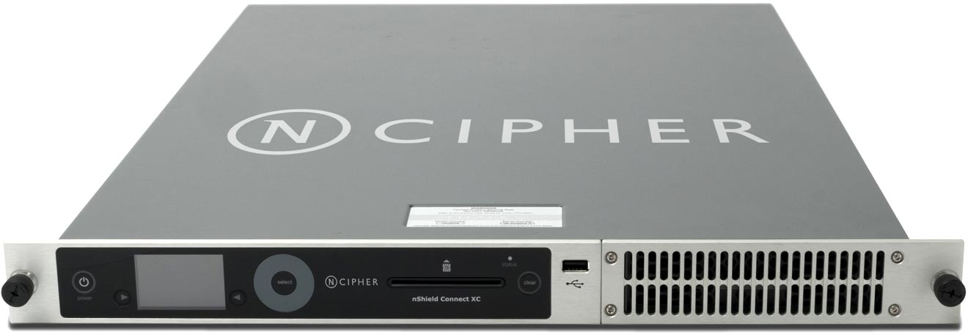
What is a Hardware Security Module (HSM)?
Hardware Security Module (HSM) is a physical device which is designed to store keys safely.
Notes:
https://en.wikipedia.org/wiki/Hardware_security_module

Slide 40

Role based access control in AWS KMS
Key Admin vs. Key User
Key Admin
Key User
"kms:Create*", "kms:Describe*", "kms:Enable*", "kms:List*", "kms:Put*", "kms:Update*", "kms:Revoke*", "kms:Disable*", "kms:Get*", "kms:Delete*", "kms:TagResource", "kms:UntagResource", "kms:ScheduleKeyDeletion", "kms:CancelKeyDeletion"
"kms:Encrypt", "kms:Decrypt", "kms:ReEncrypt*", "kms:GenerateDataKey*", "kms:DescribeKey"
Key Admin
Key Users

Slide 41
S3 Permissions and Encryption
Object Encrypted using - S3 Default Key
User | S3 Permission | Key Permission | Can they read data?
Manager | S3 Full Access | Not Applicable
Dev 1 | S3 Read | Not Applicable
Dev 2 | S3 Read | Not Applicable
Dev 3 | No S3 Permission | Not Applicable
Object Encrypted using - S3 KMS Key
User | S3 Permission | Key Permission | Can they read data?
Manager | S3 Full Access | Key Administrator
Dev 1 | S3 Read | Key User – Encrypt/Decrypt
Dev 2 | S3 Read | No Permission
Dev 3 | No S3 Permission | Key User – Encrypt/Decrypt

Slide 42

Envelope Encryption

Slide 43





Slide 44
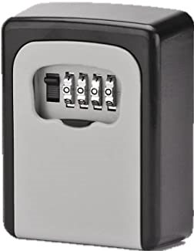

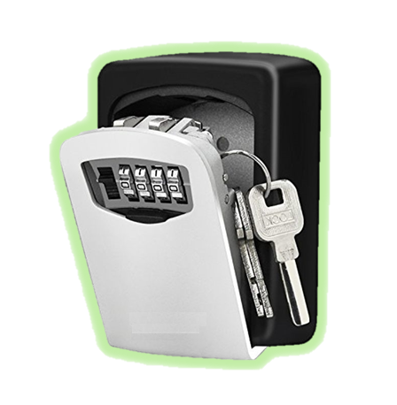

Slide 45
Encryption Process

Slide 46
Plain Text Data
A B C D
1 2 3 4

Slide 47
Crypto Service
Plain Text Data
A B C D
1 2 3 4

Slide 48

Crypto Service
Hardware
Software
Plain Text Data
A B C D
1 2 3 4

Slide 49


Crypto Service
Hardware
Master Key 1
Master Key N
Software
Plain Text Data
A B C D
1 2 3 4

Slide 50
Crypto Service
Hardware
Master Key 1
Master Key N
Software
Plain Text Data
A B C D
1 2 3 4
Encryption

Slide 51

Crypto Service
Hardware
Master Key 1
Master Key N
Software
1
Request for
Encryption Key
Plain Text Data
A B C D
1 2 3 4
Encryption

Slide 52


Crypto Service
Hardware
Master Key 1
Master Key N
Software
1
2
Request for
Encryption Key
Plain Text Data
A B C D
1 2 3 4
Plain Text
Encryption Key
Encrypted copy of
Encryption Key
Encryption

Slide 53
Crypto Service
Hardware
Master Key 1
Master Key N
Software
1
2
Request for
Encryption Key
Plain Text Data
Delivered together
A B C D
1 2 3 4
Plain Text
Encryption Key
Encrypted copy of
Encryption Key
Encryption

Slide 54
Crypto Service
Hardware
Master Key 1
Master Key N
Software
1
2
Request for
Encryption Key
Plain Text Data
Delivered together
Encrypted Data
Plain Text
Encryption Key
3
A B C D
1 2 3 4
@ £ $ %
& ~ # ?
Used for
Encryption
Encrypted copy of
Encryption Key
Encryption

Slide 55
Crypto Service
Hardware
Master Key 1
Master Key N
Software
1
2
Plain Text
Encryption Key
is discarded
Request for
Encryption Key
4
Plain Text Data
Delivered together
Encrypted Data
Plain Text
Encryption Key
3
A B C D
1 2 3 4
@ £ $ %
& ~ # ?
Used for
Encryption
Encrypted copy of
Encryption Key
Encryption

Slide 56
Crypto Service
Hardware
Master Key 1
Master Key N
Software
1
2
Plain Text
Encryption Key
is discarded
Request for
Encryption Key
4
Plain Text Data
Delivered together
Encrypted Data
3
Stored together
A B C D
1 2 3 4
Plain Text
Encryption Key
Used for
Encryption
@ £ $ %
& ~ # ?
Encrypted copy of
Encryption Key
5
Encrypted copy of
Encryption Key
Encryption
Stored with
Encrypted Data

Slide 57
Decryption Process

Slide 58
Crypto Service
Hardware
Master Key 1
Master Key N
Software
1
2
Plain Text
Encryption Key
is discarded
Decryption
Request for
Encryption Key
4
Plain Text Data
Delivered together
Encrypted Data
3
Stored together
A B C D
1 2 3 4
Plain Text
Encryption Key
Used for
Encryption
@ £ $ %
& ~ # ?
Encrypted copy of
Encryption Key
5
Encrypted copy of
Encryption Key
Encryption
Stored with
Encrypted Data

Slide 59
Crypto Service
Hardware
Master Key 1
Master Key N
Software
1
2
Plain Text
Encryption Key
is discarded
Decryption
Request for
Encryption Key
4
Plain Text Data
Delivered together
Encrypted Data
3
Stored together
A B C D
1 2 3 4
Plain Text
Encryption Key
Used for
Encryption
@ £ $ %
& ~ # ?
Encrypted copy of
Encryption Key
5
Encrypted copy of
Encryption Key
Encryption
Stored with
Encrypted Data

Slide 60
Crypto Service
Hardware
Master Key 1
Master Key N
Software
Decryption
Encrypted Data
Stored together
@ £ $ %
& ~ # ?
Encrypted copy of
Encryption Key
6
Data Retrieval
Request

Slide 61
Crypto Service
Hardware
Master Key 1
Master Key N
Software
7
Decryption
Request for Decryption
of Encryption Key
Encrypted Data
Stored together
@ £ $ %
& ~ # ?
Encrypted copy of
Encryption Key
6
Data Retrieval
Request

Slide 62
Crypto Service
Crypto service identifies the right Master Key and decrypts the Encryption key
8
Hardware
Master Key 1
Master Key N
Software
7
Decryption
Request for Decryption
of Encryption Key
Encrypted Data
Stored together
@ £ $ %
& ~ # ?
Encrypted copy of
Encryption Key
6
Data Retrieval
Request

Slide 63
Crypto Service
Crypto service identifies the right Master Key and decrypts the Encryption key
8
Hardware
Master Key 1
Master Key N
Software
Decrypted copy
of Encryption Key
7
9
Decryption
Request for Decryption
of Encryption Key
Encrypted Data
Stored together
@ £ $ %
& ~ # ?
Encrypted copy of
Encryption Key
6
Data Retrieval
Request

Slide 64
Crypto Service
Crypto service identifies the right Master Key and decrypts the Encryption key
8
Hardware
Master Key 1
Master Key N
Software
Decrypted copy
of Encryption Key
7
9
Decryption
Request for Decryption
of Encryption Key
Encrypted Data
Plain Text Data
Stored together
10
@ £ $ %
& ~ # ?
Used for
Decryption
A B C D
1 2 3 4
Encrypted copy of
Encryption Key
6
Data Retrieval
Request

Slide 65
Complete Encryption Decryption Process

Slide 66
Crypto Service
Crypto service identifies the right Master Key and decrypts the Encryption key
8
Hardware
Master Key 1
Master Key N
Software
1
2
Decrypted copy
of Encryption Key
7
Plain Text
Encryption Key
is discarded
9
Decryption
Request for
Encryption Key
Request for Decryption
of Encryption Key
4
Plain Text Data
Delivered together
Encrypted Data
Plain Text Data
3
Stored together
10
A B C D
1 2 3 4
Plain Text
Encryption Key
Used for
Encryption
@ £ $ %
& ~ # ?
Used for
Decryption
A B C D
1 2 3 4
Encrypted copy of
Encryption Key
5
Encrypted copy of
Encryption Key
Encryption
Stored with
Encrypted Data
6
Data Retrieval
Request

Slide 67






How AWS Services Integrate with KMS?
2-Tiered key hierarch using envelope encryption
Data keys encrypt customer data
KMS master keys encrypt data keys
Benefits:
Limit blast radius of compromised resources and their keys
Easier to manage a small number of keys than billions of resource keys
Better performance
AWS KMS
Primary Keys
Policy
Generates & Encrypts Data Keys
Data Key 1
Data Key 2
Data Key 3
Data Key 4
Data Key 5
Encrypts Data
S3
Object
EBS
Volume
RDS
Instance
Redshift
Cluster
Your
App

Slide 68

AWS CloudHSM

Slide 69





AWS CloudHSM
Customer A
Customer B
Customer C
AWS physically maintains the HSMs, and full logical ownership of HSM.
Your Application
Shared HSM Devices
(Multi-Tenant)
Customer A
Customer A
Customer A
AWS KMS
AWS physically maintains the HSMs, but customer get the full logical ownership of HSM.
AWS Services
Dedicated HSM Devices
(Single Tenant)
AWS CloudHSM Cluster

Slide 70
When to use CloudHSM?
 | AWS KMS | CloudHSM
Scope | AES-256 and RSA encrypt; RSA and ECC sign | Most general-purpose HSM functions (encrypt, sign /verify, derive, hash, wrap)
Secrets / keys stored in | Shared FIPS-validated HSM | Single-tenant FIPS-validated HSM in customer VPC
HSM controlled by | AWS | Customer
Scalability managed by | AWS | Customer
Keys managed by | AWS | Customer
Key access by | AWS IAM / resource policies | Customer-defined credentials
Integrated with AWS services | Yes | No
Secret / key operations implemented with | AWS CLI / SDK or Encryption SDK | Customer-built application
Rotation executed by | AWS [not for BYOK and CKS] | Customer

Slide 71
AWS KMS custom key store: best of two worlds
 | AWS KMS | KMS custom key store (CloudHSM)
Where keys are generated | HSMs controlled by AWS | HSMs controlled by you
Where keys are stored | HSMs controlled by AWS | HSMs controlled by you
Where keys are used | HSMs controlled by AWS | HSMs controlled by you
How to control key use | JSON key policies you define | JSON key policies you define
Responsibility for performance / scale | AWS | You
Integration with AWS services? | Yes | Yes
Pricing model | $1/key + usage | $1/key + usage; hourly charge for each HSM

Slide 72


Mitigation of DDoS attacks

Slide 73


What is a DDoS attack?
A restaurant at work
Notes:
https://www.imperva.com/learn/ddos/ddos-attacks/

Slide 74

What is a DDoS attack?
A restaurant at work

Slide 75

What is a DDoS attack?
A distributed denial-of-service (DDoS) attack occurs when a group of systems flood a server with fraudulent traffic.
Eventually, the server is overwhelmed, causing it to either go down, or become unresponsive, even to legitimate requests.
A DDoS attack is launched from numerous compromised devices, often distributed globally in what is referred to as a botnet.

Slide 76

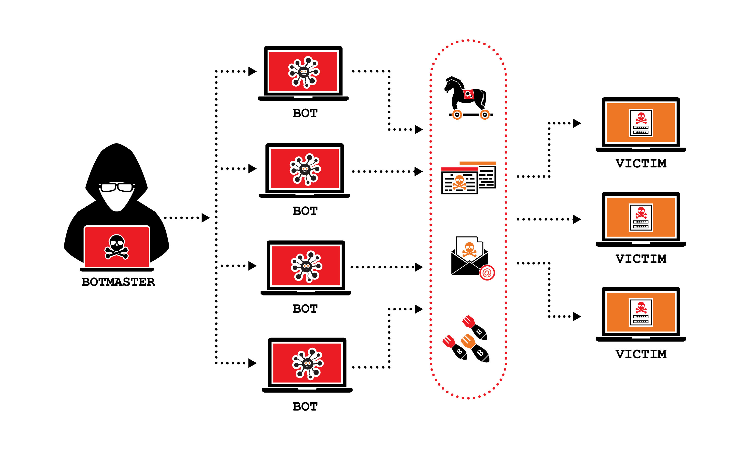








What is a DDoS attack?
Attacks
BOT
BOT
Website Down
Attacker
Victim
BOT
BOT

Slide 77
Type of DDoS Attack
Volume Based Attacks
Includes UDP floods, ICMP floods, and other spoofed-packet floods. The attack’s goal is to saturate the bandwidth of the attacked site, and magnitude is measured in bits per second (Bps).
Protocol Attacks
Includes SYN floods, fragmented packet attacks, Ping of Death, Smurf DDoS and more. This type of attack consumes actual server resources, or those of intermediate communication equipment, such as firewalls and load balancers, and is measured in packets per second (Pps).
Application Layer Attacks
Includes low-and-slow attacks, GET/POST floods, attacks that target Apache, Windows or OpenBSD vulnerabilities and more. Comprised of seemingly legitimate and innocent requests, the goal of these attacks is to crash the web server, and the magnitude is measured in Requests per second (Rps).
Notes:
https://www.imperva.com/learn/ddos/ddos-attacks/

Slide 78
Attack vectors
Application
HTTP floods, DNS query floods
7
Presentation
Transport Layer Security (TLS) abuse
6
Session
N/A
5
Transport
Synchronize (SYN) floods
4
Network
User Datagram Protocol (UDP) reflection attacks
3
Data Link
N/A
2
Physical
N/A
1

Slide 79

AWS Web Application Firewall (AWS WAF)

Slide 80
Attack vectors
Application
HTTP floods, DNS query floods
7
Presentation
Transport Layer Security (TLS) abuse
AWS Web Application
Firewall (AWS WAF)
6
Session
N/A
5
Transport
Synchronize (SYN) floods
4
Network
User Datagram Protocol (UDP) reflection attacks
3
Data Link
N/A
2
Physical
N/A
1

Slide 81
AWS Web Application Firewall (AWS WAF)
AWS WAF protects your web applications from common exploits
You can create security rules that control bot traffic and block common attack patterns such as SQL injection or cross-site scripting (XSS).
You do this by defining a web access control list (ACL) and then associating it with one or more web application resources that you want to protect.
You can protect the following resource types:
Amazon CloudFront distribution
Amazon API Gateway REST API
Application Load Balancer
AWS AppSync GraphQL API
Amazon Cognito user pool
AWS App Runner service
AWS Verified Access instance

Slide 82

AWS Shield

Slide 83
Attack vectors
Application
HTTP floods, DNS query floods
7
Presentation
Transport Layer Security (TLS) abuse
AWS Web Application
Firewall (AWS WAF)
6
Session
N/A
5
Transport
Synchronize (SYN) floods
4
Network
User Datagram Protocol (UDP) reflection attacks
3
AWS Shield
Data Link
N/A
2
Physical
N/A
1

Slide 84
AWS Shield
AWS Shield is a managed DDoS protection service that safeguards applications running on AWS.
AWS Shield Standard is automatically enabled to all AWS customers at no additional cost. AWS Shield Advanced is an optional paid service.
AWS Shield Advanced provides additional protections against more sophisticated and larger attacks for your applications running on Amazon EC2, ELB, Amazon CloudFront, AWS Global Accelerator, and Route 53.
Customers with Business or Enterprise support can also engage the Shield Response Team (SRT) 24x7 to manage and mitigate their application layer DDoS attacks.

Slide 85

AWS Firewall Manager

Slide 86
AWS Firewall Manager
AWS Firewall Manager is a security management service that allows you to centrally configure and manage firewall rules across your accounts and applications in AWS Organizations.
As new applications are created, Firewall Manager makes it easier to bring new applications and resources into compliance by enforcing a common set of security rules.
AWS Firewall Manager is integrated with AWS Organizations so you can enable AWS WAF rules, AWS Shield Advanced protections, VPC security groups, AWS Network Firewalls, and Amazon Route 53 Resolver DNS Firewall rules across multiple AWS accounts and resources from a single place.

Slide 87


Authentication & Authorization

Slide 88



Authentication & Authorization
Authentication
- Who you are?
Authorization
- What can you do?

Slide 89


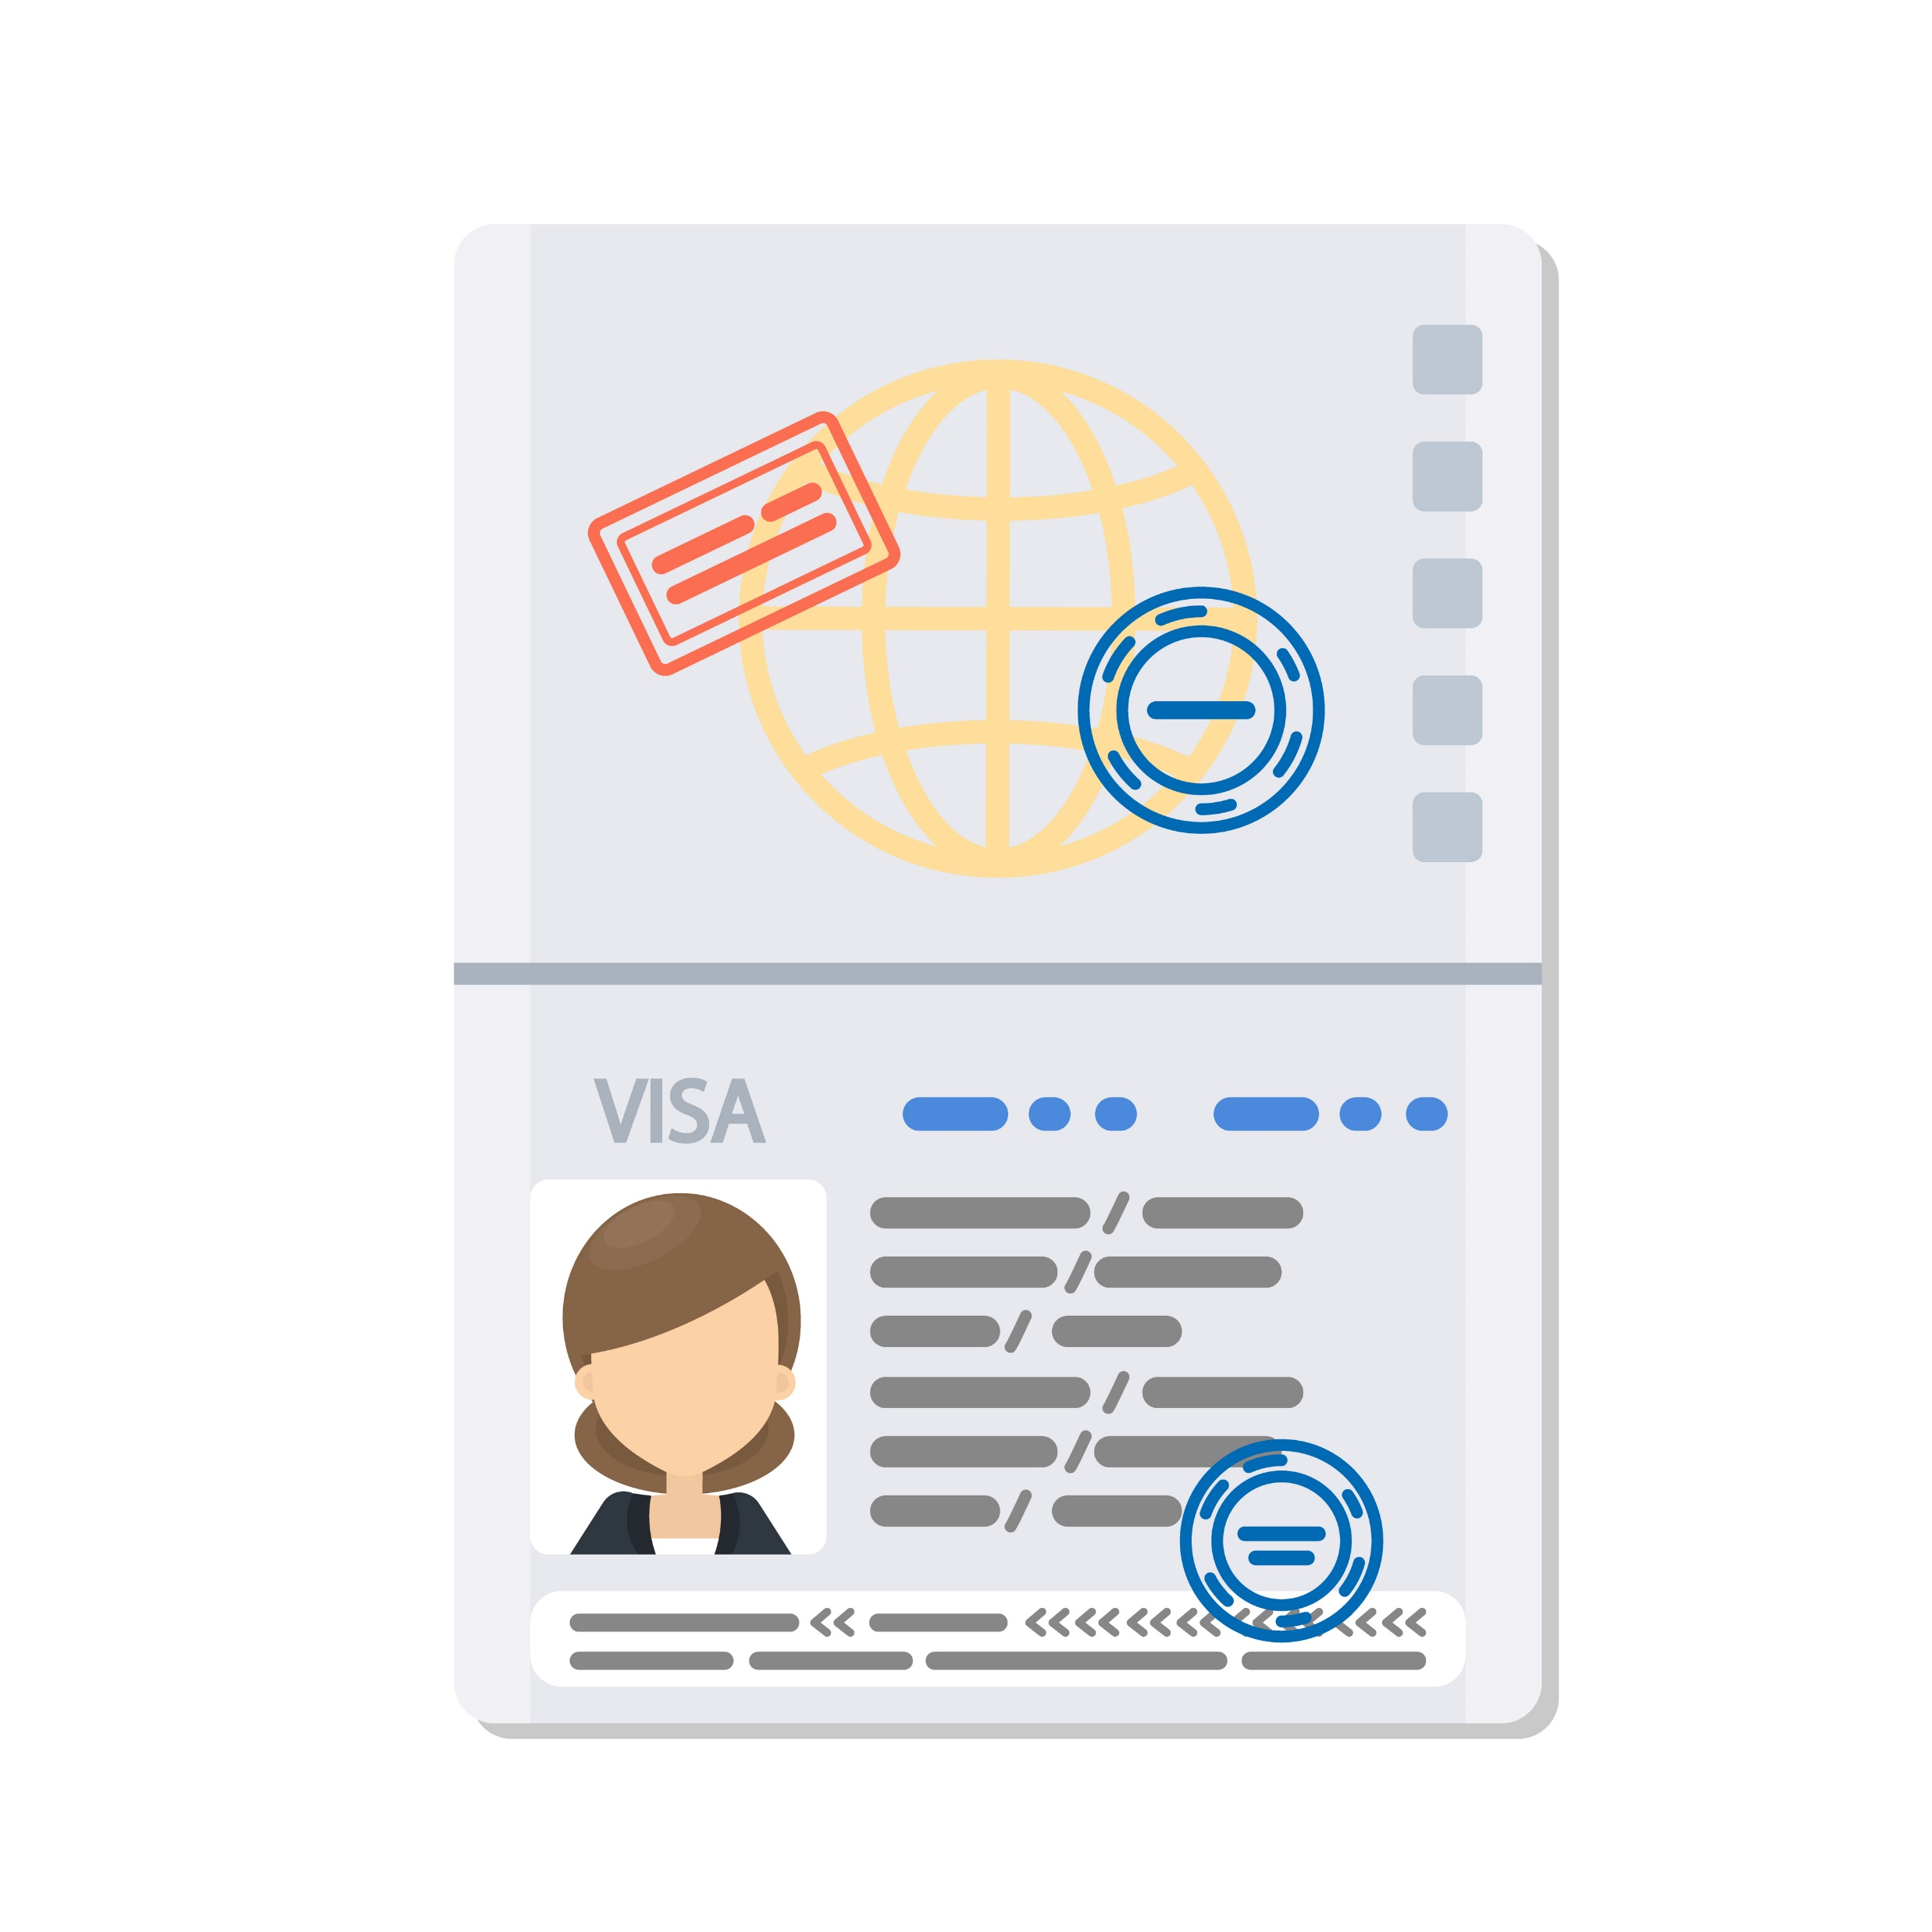
Authentication & Authorization
Passport
visa
Authentication
Who you are?
Name
Photo
DOB
Authorization
What can you do?
Transit
Work
Tourism

Slide 90

Directory Services

Slide 91

What is a directory?
A book containing an alphabetical index of the names and addresses of persons in a city, district, organization, etc., or of a particular category of people.

Slide 92

Directory services in enterprise
A directory service is a database for storing and maintaining information about users and resources.
Directory Services are often referred to as directories, user stores, Identity Stores, or LDAP Directory, and they store information such as usernames, passwords, user preferences, information about devices, and more.

Slide 93
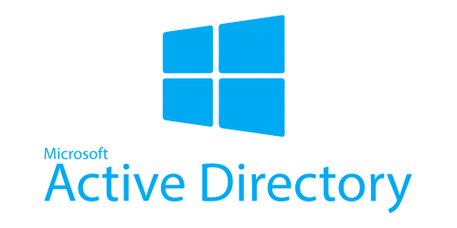
Microsoft Active Directory
Microsoft Active Directory, provides the methods for storing directory data and making this data available to network users and administrators.
For example, it stores information about user accounts, such as names, passwords, phone numbers, and so on.
Security is integrated with Active Directory through logon authentication and access control to objects in the directory.

Slide 94








Directory Services on AWS
Directory Service
helps you store information and manage access to resources.
AWS Directory Service
AWS Managed Microsoft AD
AD Connector
Simple AD
Amazon Cloud Directory
Amazon Cognito
User Pools
Notes:
AWS Managed Microsoft AD
Simple AD
AD Connector
Amazon Cogito User Pools
Cloud Directory

Slide 95
AWS Directory Service

Slide 96
AWS Directory Service
AWS Managed Microsoft AD
With AWS Managed Microsoft AD, you can easily enable your Active Directory-aware workloads and AWS resources to use managed actual Microsoft Active Directory in the AWS Cloud.
AD Connector
AD Connector is a proxy for redirecting directory requests to your existing Microsoft Active Directory without caching any information in the cloud.
Simple AD
Simple AD is a standalone managed directory that is powered by a Linux-Samba Active Directory–compatible server.
AWS Managed Microsoft AD
AD Connector
Simple AD

Slide 97
Which to choose?
Select AWS Directory Service for Microsoft Active Directory (Standard Edition or Enterprise Edition) if you need an actual Microsoft Active Directory in the AWS Cloud.
Use AD Connector if you only need to allow your on-premises users to log in to AWS applications and services with their Active Directory credentials. You can also use AD Connector to join Amazon EC2 instances to your existing Active Directory domain.
Use Simple AD if you need a low-scale, low-cost directory with basic Active Directory compatibility that supports Samba 4–compatible applications, or you need LDAP compatibility for LDAP-aware applications.
AWS Managed Microsoft AD
AD Connector
Simple AD
Notes:
Simple AD supports basic Active Directory features such as user accounts, group memberships, joining a Linux domain or Windows based EC2 instances, Kerberos-based SSO, and group policies.

Slide 98
Amazon Cloud Directory

Slide 99
Amazon Cloud Directory
Cloud Directory is a high-performance, serverless, hierarchical data store.
At its core, Cloud Directory is a specialized graph-based directory store that provides a foundational building block for developers.
Cloud Directory is not a directory service for IT Administrators who want to manage or migrate their directory infrastructure.
Cloud Directory comes ready with sample schemas for Organizations, Persons, and Devices.
Amazon Cloud Directory

Slide 100
Amazon Cognito

Slide 101
Amazon Cognito User Pools
Amazon Cognito user pools are a managed service that lets you add secure authentication and authorization to your apps, and can scale to support millions of users.
A User Pool is your user directory that you can configure for your web and mobile apps. A User Pool securely stores your users’ profile attributes.
Use Amazon Cognito if you develop high-scale SaaS applications and need a scalable directory to manage and authenticate your subscribers and that works with social media identities.
Amazon Cognito
User Pools

Slide 102
AWS IAM Identity Center
(Previously AWS Single Sign-on)

Slide 103



Accessing AWS accounts and applications without AWS IAM Identity Center
Username 1 / Password 1
AWS Account 1
27229163910
Username 2 / Password 2
AWS Account 2
536319031239
Username 3 / Password 3
AWS Account N
182367136291
User
Username 4 / Password 4
Application 1
Username N / Password N
Application N

Slide 104

Accessing AWS accounts and applications with AWS IAM Identity Center
AWS Account 1
27229163910
Permission Sets
(IAM Job Functions)
AWS Account 2
536319031239
AWS Organizations
SSO Portal
Username / Password
AWS Account N
182367136291
User
Application 1
Identity Source
Local Directory
Register Applications
Active Directory
Application N
External IdP (SAML)

Slide 105
Resource Access Manager

Slide 106
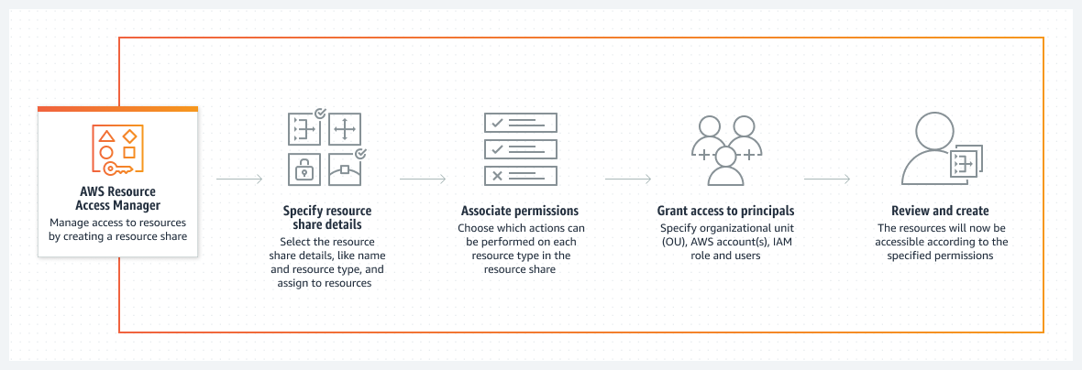
AWS Resource Access Manager
AWS RAM helps you securely share your resources across AWS accounts, within your organization or organizational units (OUs), and with IAM roles and users for supported resource types.

Slide 107
AWS Secrets Manager

Slide 108
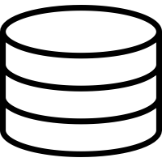
Without AWS Secrets Manager
Application Code < / >
Access Credentials are hardcoded in the application
Connect to DB…
Username = ABC
Password = 123
…… ….. …… …… ….. …… …...
…… ….. …… …… ….. …… ……
…… ….. …… …… ….. …… ……
Database
Username = ABC
Password = 123

Slide 109

With AWS Secrets Manager
AWS Secrets Manager
DB Credentials
%Secret1% = ABC
%Secret2% = 123
Application Code < / >
Retrieve access Credentials from AWS Secrets Manager
Connect to DB…
Username = %Secret1%
Password = %Secret2%
…… ….. …… …… ….. …… …...
…… ….. …… …… ….. …… ……
…… ….. …… …… ….. …… ……
Request
Response
Database
ABC
Username = ABC
123
Password = 123

Slide 110


With AWS Secrets Manager – Rotate Secrets
Generate New Credentials
AWS Secrets Manager
Lambda function
DB Credentials
%Secret1% = ABC
%Secret2% = 123
Rotate Secret
PQR
456
PQR
456
Application Code < / >
Retrieve access Credentials from AWS Secrets Manager
Connect to DB…
Username = %Secret1%
Password = %Secret2%
…… ….. …… …… ….. …… …...
…… ….. …… …… ….. …… ……
…… ….. …… …… ….. …… ……
Request
Response
Database
ABC
PQR
Username = ABC
123
456
Password = 123

Slide 111
AWS Secrets Manager
AWS Secrets Manager helps you manage, retrieve, and rotate database credentials, application credentials, OAuth tokens, API keys, and other secrets throughout their lifecycles.
Secrets Manager helps you improve your security posture, because you no longer need hard-coded credentials in application source code.
You replace hard-coded credentials with a runtime call to the Secrets Manager service to retrieve credentials dynamically when you need them.
With Secrets Manager, you can configure an automatic rotation schedule for your secrets.

Slide 112
AWS Foundational and Layered Security Services
AWS
Security
Hub
AWS
Organizations
AWS Transit Gateway
Amazon
VPC
AWS IoT Device Defender
Amazon Cloud Directory
Amazon GuardDuty
Amazon CloudWatch
AWS Step
Functions
AWS
OpsWorks
AWS Control Tower
AWS Trusted Advisor
Amazon VPC PrivateLink
AWS
Direct Connect
Resource Access manager
AWS Directory Service
Amazon Inspector
AWS Systems Manager
AWS Lambda
AWS CloudFormation
Automate
Identify
Protect
Detect
Respond
Recover
Investigate
AWS Service Catalog
AWS Config
AWS Shield
IAM
AWS Secrets Manager
KMS
Amazon Cognito
Amazon Macie
Amazon CloudWatch
AWS CloudTrail
Amazon S3
Glacier
Amazon Detective
AWS Well-Architected Tool
AWS
Systems Manager
AWS WAF
AWS Firewall Manager
AWS Certificate Manager
AWS CloudHSM
AWS IAM Identity Center
AWS
Security Hub
Snapshot
Archive
Personal Health Dashboard
Amazon
Route 53

Slide 113

Detect

Slide 114
AWS Foundational and Layered Security Services
AWS
Security
Hub
AWS
Organizations
AWS Transit Gateway
Amazon
VPC
AWS IoT Device Defender
Amazon Cloud Directory
Amazon GuardDuty
Amazon CloudWatch
AWS Step
Functions
AWS
OpsWorks
AWS Control Tower
AWS Trusted Advisor
Amazon VPC PrivateLink
AWS
Direct Connect
Resource Access manager
AWS Directory Service
Amazon Inspector
AWS Systems Manager
AWS Lambda
AWS CloudFormation
Automate
Identify
Protect
Detect
Respond
Recover
Investigate
AWS Service Catalog
AWS Config
AWS Shield
IAM
AWS Secrets Manager
KMS
Amazon Cognito
Amazon Macie
Amazon CloudWatch
AWS CloudTrail
Amazon S3
Glacier
Amazon Detective
AWS Well-Architected Tool
AWS
Systems Manager
AWS WAF
AWS Firewall Manager
AWS Certificate Manager
AWS CloudHSM
AWS IAM Identity Center
AWS
Security Hub
Snapshot
Archive
Personal Health Dashboard
Amazon
Route 53

Slide 115
Amazon GuardDuty

Slide 116













Why we need Amazon GuardDuty?
A typical enterprise architecture
AWS account 1
AWS account 2
AWS account N
Virtual private cloud (VPC)
Virtual private cloud (VPC)
Virtual private cloud (VPC)
Users
Users
Users
Instances
Instances
Instances
Instances
Instances
Instances
Instances
Instances
Instances

Slide 117

Finding a needle in the haystack

Slide 118

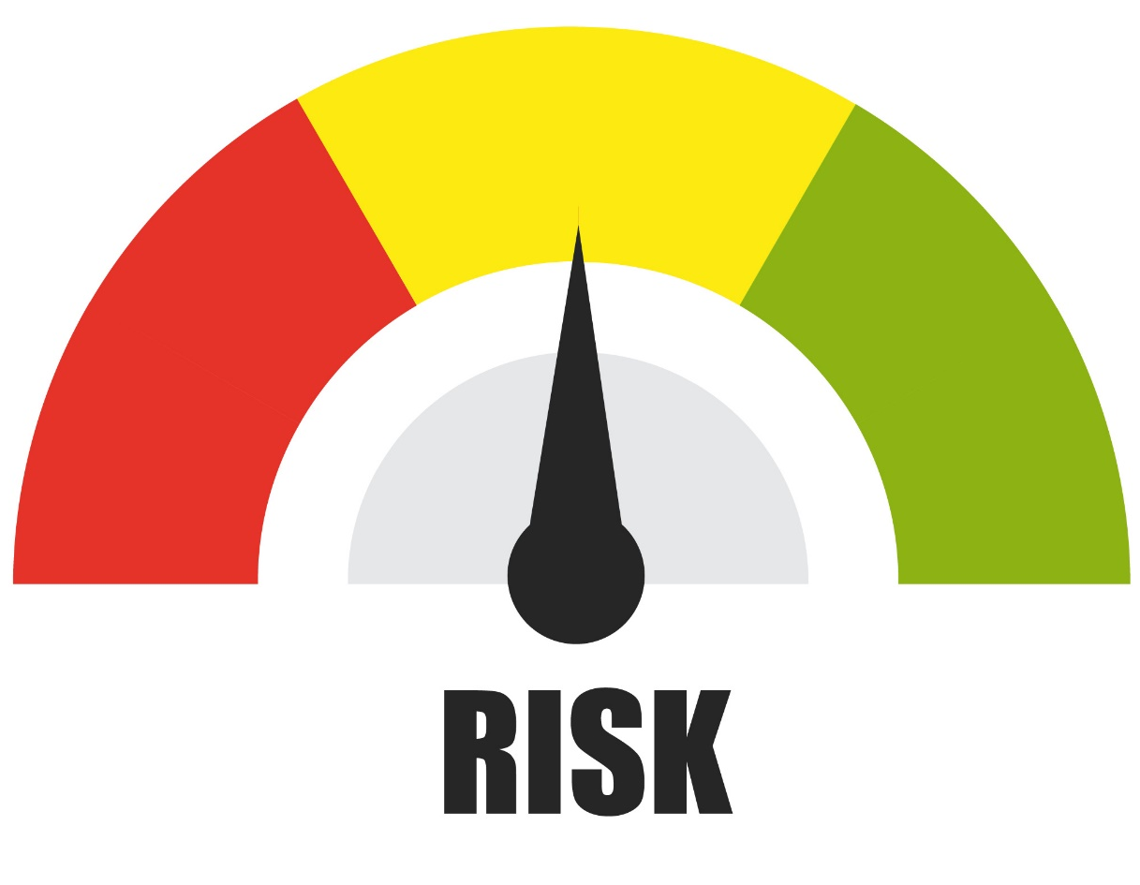



Why we need Amazon GuardDuty?
A typical enterprise architecture
AWS account 1
AWS account 2
AWS account N
Virtual private cloud (VPC)
Virtual private cloud (VPC)
Virtual private cloud (VPC)
Users
Users
Users
Instances
Instances
Instances
Instances
Instances
Instances
Instances
Instances
Instances
Machine
Learning
Medium
VPC flow logs
DNS logs
AWS CloudTrail events
Malware
Scanning
Threat
Intelligence
High
Low
Take Action
(Remediate)
Amazon GuardDuty

Slide 119
Amazon GuardDuty
Amazon GuardDuty is a threat detection service that continuously monitors your AWS accounts and workloads for malicious activity and delivers detailed security findings for visibility and remediation.
It analyzes and processes Foundational data sources, such as AWS CloudTrail management events, AWS CloudTrail event logs, VPC flow logs (from Amazon EC2 instances), and DNS logs.
It also processes Features such as Kubernetes audit logs, RDS login activity, S3 logs, EBS volumes, Runtime monitoring, and Lambda network activity logs.
It uses threat intelligence feeds, such as lists of malicious IP addresses and domains, and machine learning to identify unexpected, potentially unauthorized, and malicious activity within your AWS environment.

Slide 120
Amazon Inspector

Slide 121





Amazon Inspector
Amazon Inspector is an automated vulnerability management service that continually scans AWS workloads for software vulnerabilities and unintended network exposure.
A vulnerability is a weakness that can be exploited by cybercriminals to gain unauthorized access to a system.
Instances
EC2 Instance
Amazon Inspector
Containers
Containers
AWS Lambda
Lambda Functions

Slide 122






Automated vulnerability management through Amazon Inspector
Automate actions
AWS
Security Hub
Take actions
Amazon EventBridge
AWS Step
Functions
AWS Lambda
Amazon Inspector
Detect vulnerabilities
Export reports, long term retention
Amazon S3 Bucket

Slide 123
AWS Security Hub

Slide 124
AWS Security Hub
AWS Security Hub is a cloud security posture management service that continuously performs security best practice checks and seamlessly aggregates security findings from AWS and third-party services and enables automated response.
Security Hub ingests findings from multiple AWS services, including Amazon GuardDuty, Amazon Inspector, AWS Firewall Manager, and AWS Health, and also from third-party services.
It can be integrated with AWS Organizations to provide a single dashboard where you can view findings across your organization.

Slide 125














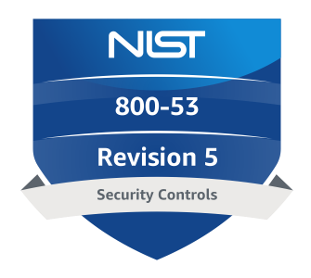
















AWS Security Hub
Findings ingestions
AWS Security Hub
Remediation actions
AWS Config
Amazon GuardDuty
Amazon Inspector
AWS IAM
Amazon Macie
AWS Firewall Manager
AWS Lambda
AWS Systems Manager
AWS Step Functions
Amazon EventBridge
…and many more
Findings integrations
Standards and controls
Take action with partners
Amazon Detective
AWS Audit
Manager
Security Lake
PCI DSS
NIST
AWS FSBP
AWS Trusted Advisor
AWS Chatbot
…plus many others
CIS AWS Foundations Benchmark
Service-managed
standards

Slide 126
Amazon Macie

Slide 127
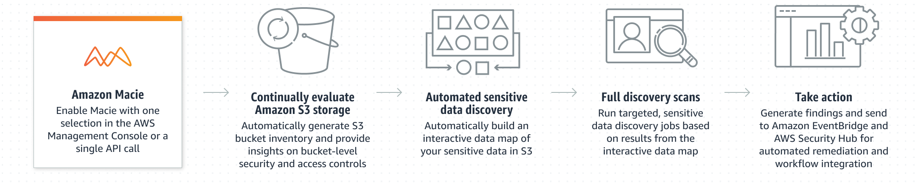
Amazon Macie
Amazon Macie is a data security service that discovers sensitive data by using machine learning and pattern matching, provides visibility into data security risks, and enables automated protection against those risks.
If Macie detects a potential issue with the security or privacy of your data, such as a bucket that becomes publicly accessible, Macie generates a finding for you to review and remediate as necessary.

Slide 128

Respond

Slide 129
AWS Foundational and Layered Security Services
AWS
Security
Hub
AWS
Organizations
AWS Transit Gateway
Amazon
VPC
AWS IoT Device Defender
Amazon Cloud Directory
Amazon GuardDuty
Amazon CloudWatch
AWS Step
Functions
AWS
OpsWorks
AWS Control Tower
AWS Trusted Advisor
Amazon VPC PrivateLink
AWS
Direct Connect
Resource Access manager
AWS Directory Service
Amazon Inspector
AWS Systems Manager
AWS Lambda
AWS CloudFormation
Automate
Identify
Protect
Detect
Respond
Recover
Investigate
AWS Service Catalog
AWS Config
AWS Shield
IAM
AWS Secrets Manager
KMS
Amazon Cognito
Amazon Macie
Amazon CloudWatch
AWS CloudTrail
Amazon S3
Glacier
Amazon Detective
AWS Well-Architected Tool
AWS
Systems Manager
AWS WAF
AWS Firewall Manager
AWS Certificate Manager
AWS CloudHSM
AWS IAM Identity Center
AWS
Security Hub
Snapshot
Archive
Personal Health Dashboard
Amazon
Route 53

Slide 130
AWS Systems Manager

Slide 131

















AWS Systems Manager
AWS Systems Manager is the operations hub for your AWS applications and resources and a secure end-to-end management solution for hybrid and multicloud environments that enables secure operations at scale.
Automation
Documents
Patch Manager
Parameter Store
AWS Systems Manager
Inventory
State Manager
Run Command
Incident Manager
Capabilities
Change Calendar
Compliance
Application Manager
Distributor
Session Manager
Change Manager
OpsCenter
Maintenance Windows
Workshop

Slide 132




Managing nodes using the AWS Systems Manager agent
Activation Key
On-Prem Server
SSM
Agent
Automation
Documents
Internet
AWS Systems Manager
Virtual private cloud (VPC)
Inventory
State
Manager
Public Subnet
Amazon EC2
Capabilities
IAM Role
SSM
Agent
Patch Manager
Run
Command
Private Subnet
Amazon EC2
Session Manager
Change Manager
IAM Role
VPC Endpoints
SSM
Agent

Slide 133
Session Manager
Session Manager lets you manage your EC2 instances, on-premises servers, edge devices, and virtual machines (VMs), including VMs in other cloud environments, through an interactive one-click browser-based shell or through the AWS CLI.
Session Manager provides secure and auditable instance management without the need to open inbound ports, maintain bastion hosts, or manage SSH keys.
Session Manager

Slide 134

Documents
An AWS Systems Manager document (SSM document) the configuration options, policies, and the actions that Systems Manager performs on your managed instances and other AWS resources.
Documents use JavaScript Object Notation (JSON) or YAML, and they include steps and parameters that you specify.
You can use pre-defined AWS managed documents or create your own depending on your use case.
Documents
Example
Notes:
https://aws.amazon.com/blogs/mt/amazon-ec2-systems-manager-documents-support-for-cross-platform-documents-and-multiple-steps-of-the-same-type/

Slide 135
State Manager
State Manager automates the process of keeping your managed nodes and other AWS resources in a state that you define.
State Manager offers the following benefits for managing your nodes
Bootstrap nodes with specific software at start-up.
Download and update agents on a defined schedule, including the SSM Agent.
Join nodes to a Microsoft Active Directory domain.
Patch nodes with software updates throughout their lifecycle.
Run scripts on managed nodes throughout their lifecycle.
An association includes three components and one optional set of components:
A Command or Automation document that defines the state.
Target(s), which can be managed nodes or other AWS resources.
A schedule for when or how often to apply the state.
(Optional) Runtime parameters specific to the document.
State Manager

Slide 136
Patch Manager
You can patch Amazon EC2 instances, edge devices, and on-premises servers and virtual machines (VMs), including VMs in other cloud environments.
You can scan instances to see only a report of missing patches, or you can scan and automatically install all missing patches.
You can target instances individually or in large groups by using resource tags or Resource Groups.
Patch Manager doesn’t support upgrading major versions of operating systems, such as Windows Server 2016 to Windows Server 2019, or SUSE Linux Enterprise Server (SLES) 12.0 to SLES 15.0.
Patch Manager

Slide 137
Run Commands
Run Command lets you remotely and securely manage the configuration of your managed instances. Run Command enables you to automate common administrative tasks and perform ad-hoc configuration changes at scale.
You can use Run Command from the AWS Management Console, the AWS Command Line Interface, AWS Tools for Windows PowerShell, or the AWS SDKs.
Administrators use Run Command to install or bootstrap applications, build a deployment pipeline, capture log files when an instance is removed from an Auto Scaling group, join instances to a Windows domain, and more.
Run Command
Notes:
https://aws.amazon.com/blogs/mt/amazon-ec2-systems-manager-documents-support-for-cross-platform-documents-and-multiple-steps-of-the-same-type/

Slide 138
Change Manager
Change Manager, a capability of AWS Systems Manager, is an enterprise change management framework for requesting, approving, implementing, and reporting on operational changes to your application configuration and infrastructure.
With Change Manager, you can use preapproved change templates to help automate change processes for your resources and help avoid unintentional results when making operational changes.
Change templates can be helpful during audits to show how standard changes are made.
Change Manager

Slide 139
AWS Foundational and Layered Security Services
AWS
Security
Hub
AWS
Organizations
AWS Transit Gateway
Amazon
VPC
AWS IoT Device Defender
Amazon Cloud Directory
Amazon GuardDuty
Amazon CloudWatch
AWS Step
Functions
AWS
OpsWorks
AWS Control Tower
AWS Trusted Advisor
Amazon VPC PrivateLink
AWS
Direct Connect
Resource Access manager
AWS Directory Service
Amazon Inspector
AWS Systems Manager
AWS Lambda
AWS CloudFormation
Automate
Identify
Protect
Detect
Respond
Recover
Investigate
AWS Service Catalog
AWS Config
AWS Shield
IAM
AWS Secrets Manager
KMS
Amazon Cognito
Amazon Macie
Amazon CloudWatch
AWS CloudTrail
Amazon S3
Glacier
Amazon Detective
AWS Well-Architected Tool
AWS
Systems Manager
AWS WAF
AWS Firewall Manager
AWS Certificate Manager
AWS CloudHSM
AWS IAM Identity Center
AWS
Security Hub
Snapshot
Archive
Personal Health Dashboard
Amazon
Route 53

Slide 140
Incident Manager
Incident
General Definition – Unusual or unexpected happening
IT Definition – An issue with application or service
AWS Systems Manager Incident Manager provides a step-by-step framework based on best practices to identify and react to incidents, such as service outages or security threats.
The primary focus of Incident Manager is to help restore affected services or applications to normal as quickly as possible through a complete incident lifecycle management solution.
Incident Manager
Example
Notes:
https://aws.amazon.com/blogs/security/how-to-automate-incident-response-to-security-events-with-aws-systems-manager-incident-manager

Slide 141
























Incident Management
Incident
Detect
Raise an Incident
Engage the right team
Preliminary Check
First Aid
(Stage 1)
Air Ambulance
(Stage 2)
Escalation
Manual or
Automated
Detect
Response Plan
Incident
Detect
Start Incident
Engage
Contacts
Preliminary Check
Runbook
(Stage 1)
Escalation Plan
(Stage 2)
Manual or
Automated
Alarm
Amazon
CloudWatch
Email
Logs
SMS
Amazon
EventBridge

Slide 142
Amazon Detective

Slide 143
AWS Foundational and Layered Security Services
AWS
Security
Hub
AWS
Organizations
AWS Transit Gateway
Amazon
VPC
AWS IoT Device Defender
Amazon Cloud Directory
Amazon GuardDuty
Amazon CloudWatch
AWS Step
Functions
AWS
OpsWorks
AWS Control Tower
AWS Trusted Advisor
Amazon VPC PrivateLink
AWS
Direct Connect
Resource Access manager
AWS Directory Service
Amazon Inspector
AWS Systems Manager
AWS Lambda
AWS CloudFormation
Automate
Identify
Protect
Detect
Respond
Recover
Investigate
AWS Service Catalog
AWS Config
AWS Shield
IAM
AWS Secrets Manager
KMS
Amazon Cognito
Amazon Macie
Amazon CloudWatch
AWS CloudTrail
Amazon S3
Glacier
Amazon Detective
AWS Well-Architected Tool
AWS
Systems Manager
AWS WAF
AWS Firewall Manager
AWS Certificate Manager
AWS CloudHSM
AWS IAM Identity Center
AWS
Security Hub
Snapshot
Archive
Personal Health Dashboard
Amazon
Route 53

Slide 144
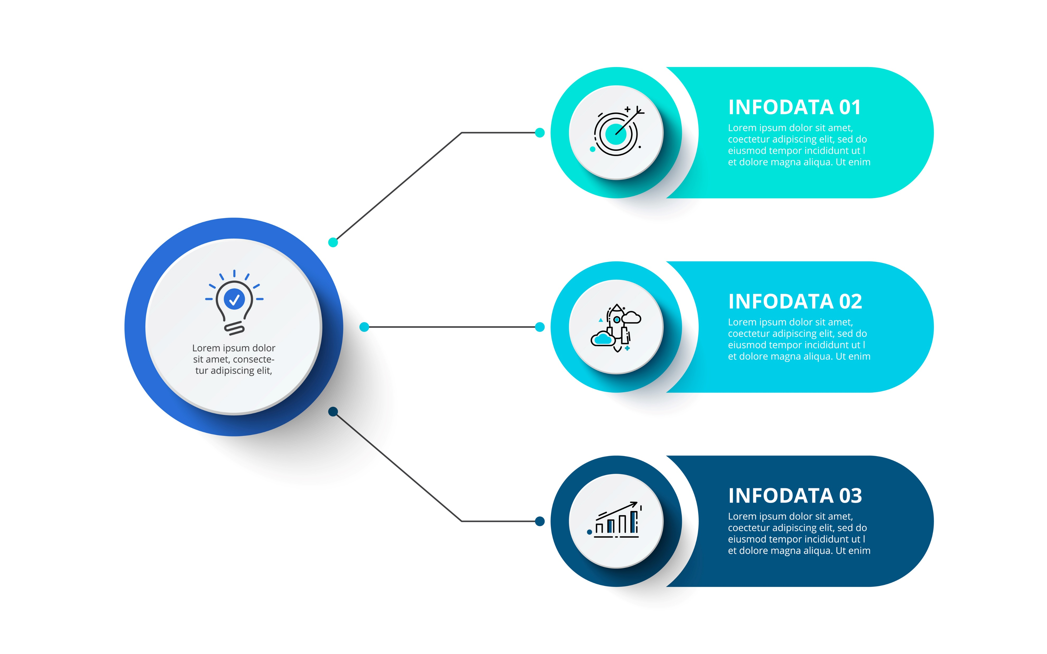



Amazon Detective
Finding/alert triage
Accelerate triage and avoid
unnecessary escalations
Alert
Analysis
Incident investigation
Improve context and surface correlated behaviour
Incident
Response
Amazon Detective
Threat hunting
Simplify data collection,
aggregation, and pivoting
Threat
Hunting
Notes:
When security findings are investigated in isolation, it can lead to a misinterpretation of their significance and difficulty in finding the root cause.
Amazon Detective helps you analyze, investigate, and quickly identify the root cause of security findings or suspicious activities.
You have just been alerted of suspected malicious or high-risk activity in your environment. It is your job to determine if the alert is a true positive (genuine malicious activity) or false positive (non-malicious activity). In addition to determining validity you need to discover what resources are involved, and assess the severity of the finding to understand who needs to be notified and what playbook to follow.

Slide 145


How Amazon Detective processes source data?
Source
Amazon Detective
VPC network traffic
Behaviour
Graph
Populates
AWS CloudTrail
Console
Amazon GuardDuty
Analyzed by
Populates
Notes:
Detective automatically collects log data from your AWS resources. It then uses machine learning, statistical analysis, and graph theory to generate visualizations that help you conduct faster and more efficient security investigations. The Detective prebuilt data aggregations, summaries, and context help you to quickly analyze and determine the nature and extent of possible security issues. In this workshop, learn the basics of Amazon Detective as you walk through different use cases.

Slide 146




Security behaviour graph
connected
detected
assigned
IP address
EKS pod
GuardDuty finding
attached
used
EC2
found
user agent
assumed
Inspector finding
IAM role
IAM user

Slide 147






Scenario walkthrough
Security Group
Port 22 Open
List API
Unauthorized user controlled domain
Launches…
S3 bucket
Exfiltrates data
EC2 instance
Disable API
Dev team
Exploitation
successful
Port Scan
Amazon GuardDuty
Delete API
GPU instance
GPU instance
Use that role to…
Privilege Enumeration
AWS CloudTrail
GPU instance
GPU instance
Unauthorized User
Bitcoin miners
GuardDuty Findings

Slide 148
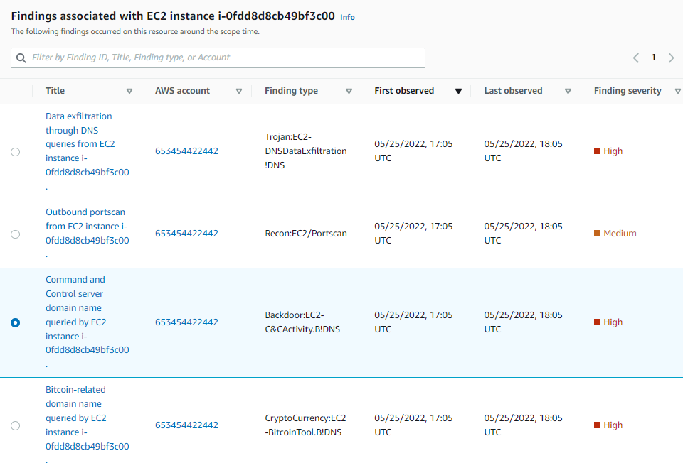
Investigation - So what happened?

Slide 149
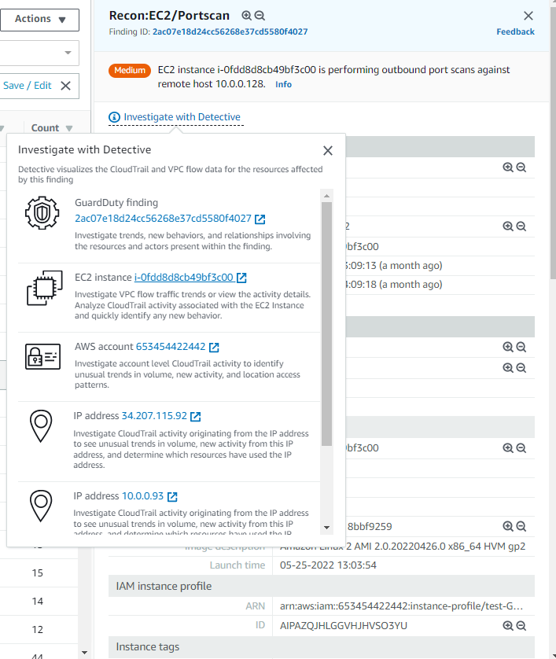
Investigation
Start in GuardDuty, initial event
Choose Investigate with Detective
Open up the impacted EC2 instance

Slide 150
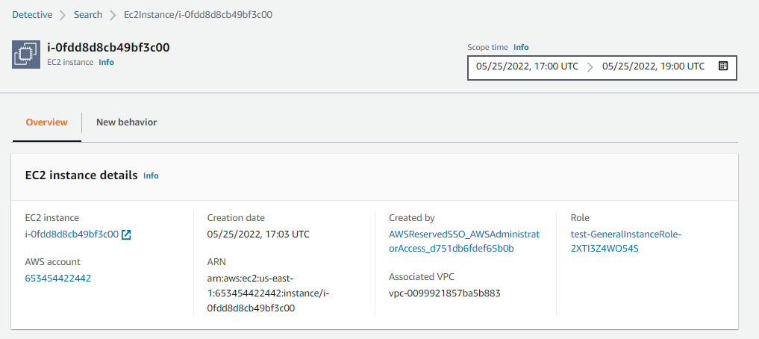
Investigation

Slide 151
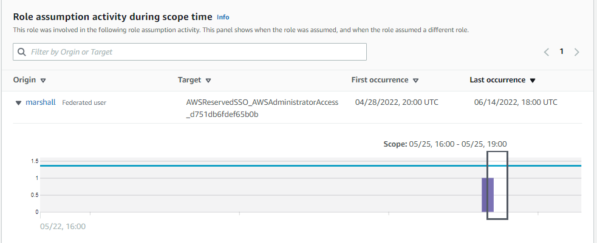
Investigation

Slide 152
What questions do we need to answer?
Can we determine what else the role has been doing? Was it successful in other suspicious activity?
Can we identify the IP associated with the malicious domain?
Was the IP interacting with other resources in the environment?
Can we determine what data was exfiltrated?

Slide 153
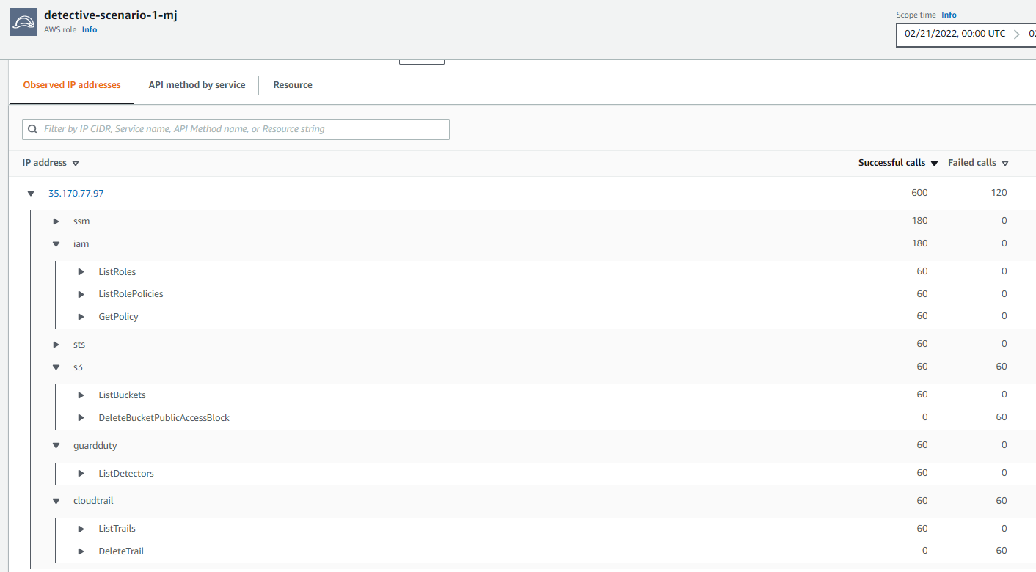
Answer questions with Detective
What IAM permissions do I have?
Which S3 buckets can I read?
Can I disable Cloudtrail to cover my tracks?
Failed calls

Slide 154
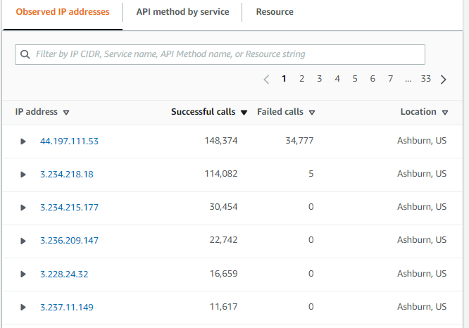
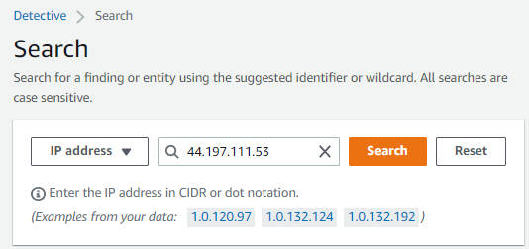
Answer questions with Detective

Slide 155
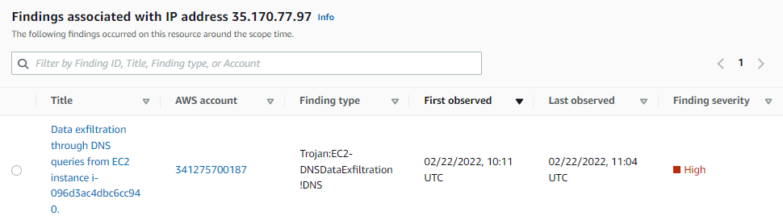
Answer questions with Detective
GuardDuty finding of Data Exfiltration to known DNS name

Slide 156
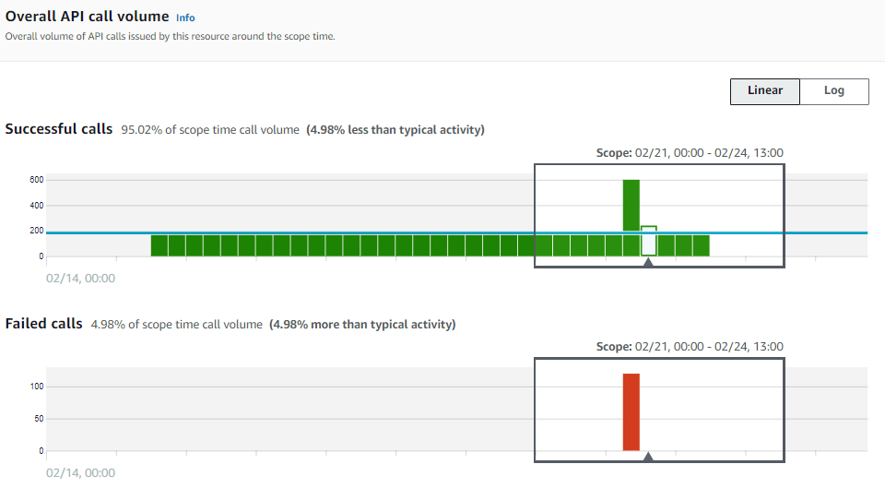
Answer questions with Detective
Timeframe
Successful calls, showing a spike
Some failed calls for services the role doesn’t have access to

Slide 157
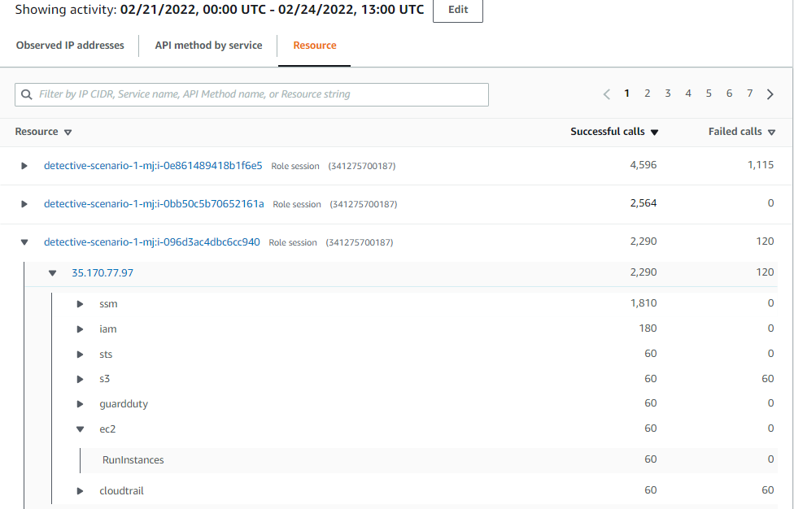
Answer questions with Detective
Scope time indicates this occurred on Feb 21
60 successful RunInstances calls indicating 60 bitcoin miners were created
Execute Incident Response

Slide 158

Automating Incident Response

Slide 159
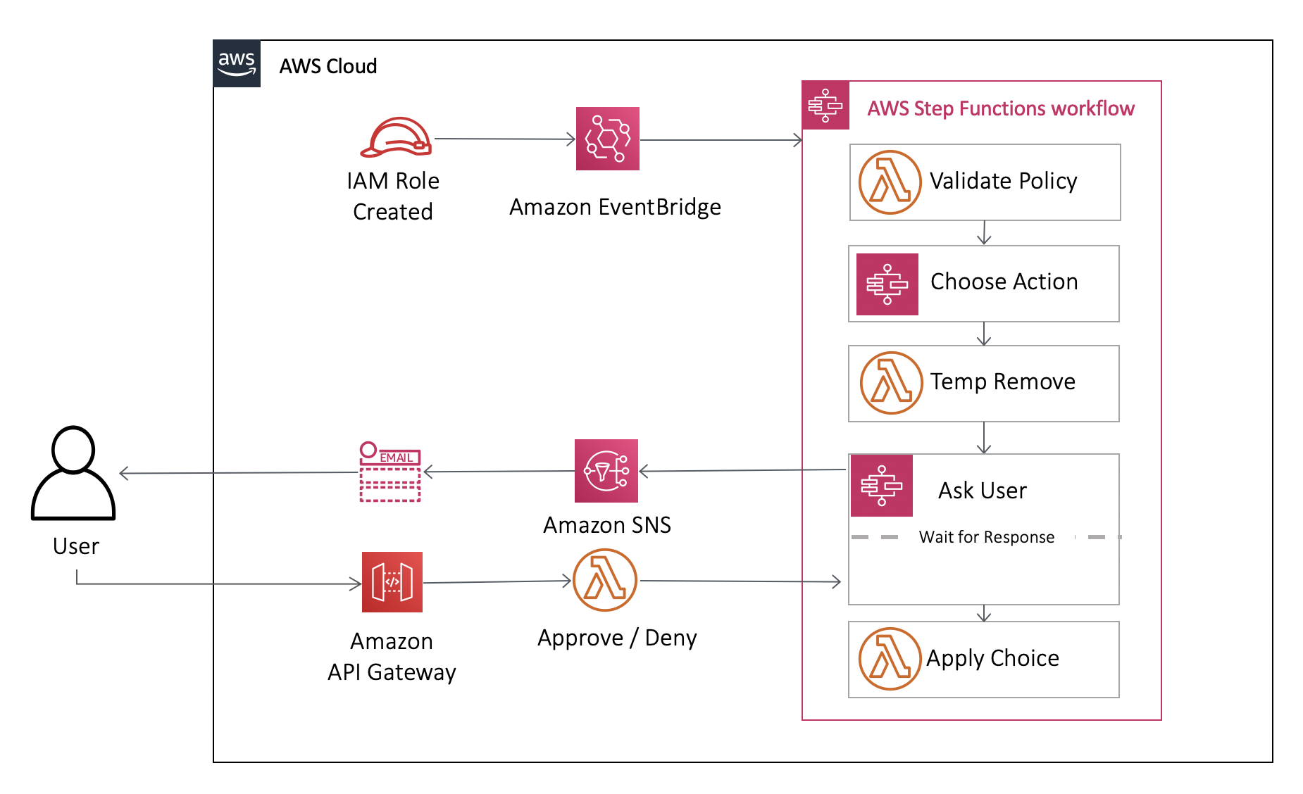
Orchestrating a security incident response with AWS Step Functions
Notes:
https://aws.amazon.com/blogs/compute/orchestrating-a-security-incident-response-with-aws-step-functions/

Slide 160

Amazon Route 53
Health Checks

Slide 161

Route 53 health checks
Route 53 health checks monitor the health and performance of your application's servers, or endpoints, from a network of health checkers in locations around the world.
You can specify either a domain name or an IP address and a port to create HTTP, HTTPS, and TCP health checks that check the health of the endpoint.

Slide 162

AWS Health Dashboard

Slide 163
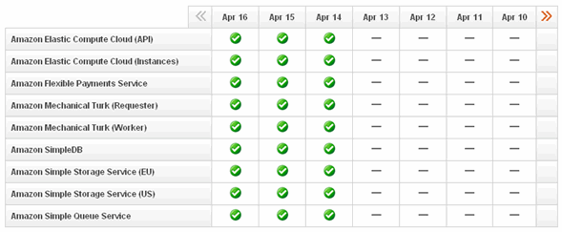
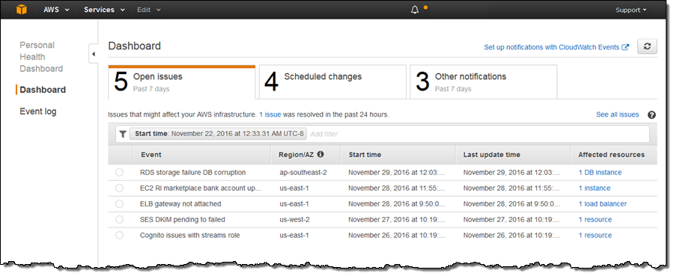

AWS Health Dashboard
The AWS Health Dashboard is the single place to learn about the availability and operations of AWS services.
AWS Service Health Dashboard
AWS Personal Health Dashboard
Aggregation
Integration
AWS Organizations
AWS Health Dashboard
Amazon EventBridge
Automate Action
Notes:
https://aws.amazon.com/blogs/mt/learning-about-aws-service-health-with-the-new-aws-health-dashboard/

Slide 164
AWS Foundational and Layered Security Services
AWS
Security
Hub
AWS
Organizations
AWS Transit Gateway
Amazon
VPC
AWS IoT Device Defender
Amazon Cloud Directory
Amazon GuardDuty
Amazon CloudWatch
AWS Step
Functions
AWS
OpsWorks
AWS Control Tower
AWS Trusted Advisor
Amazon VPC PrivateLink
AWS
Direct Connect
Resource Access manager
AWS Directory Service
Amazon Inspector
AWS Systems Manager
AWS Lambda
AWS CloudFormation
Automate
Identify
Protect
Detect
Respond
Recover
Investigate
AWS Service Catalog
AWS Config
AWS Shield
IAM
AWS Secrets Manager
KMS
Amazon Cognito
Amazon Macie
Amazon CloudWatch
AWS CloudTrail
Amazon S3
Glacier
Amazon Detective
AWS Well-Architected Tool
AWS
Systems Manager
AWS WAF
AWS Firewall Manager
AWS Certificate Manager
AWS CloudHSM
AWS IAM Identity Center
AWS
Security Hub
Snapshot
Archive
Personal Health Dashboard
Amazon
Route 53

Slide 165
AWS Well-Architected Tool

Slide 166
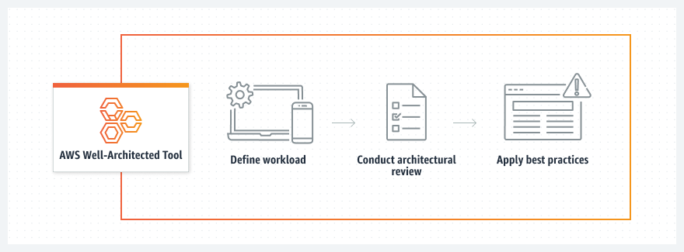
AWS Well-Architected Tool
The AWS Well-Architected Tool is designed to help you review the state of your applications and workloads against architectural best practices, identify opportunities for improvement, and track progress over time.

Slide 167
AWS Service Catalog

Slide 168
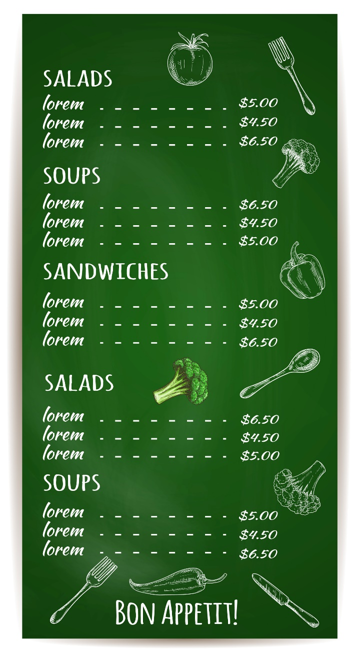


Fancy having a meal…

Slide 169

Chefs know it better

Slide 170

Add dressing (if needed)…

Slide 171

Current scenario
Developer
Which version of PHP should be used?
What tags are relevant for my workload?
Security Team
Which VPC is suitable for deploying forensic instance?
Where is the latest AMI?
Sys Admins
What are best practices for deploying EKS cluster?
Do we have a template for 3-Tier App?

Slide 172
In AWS Context
AWS Service Catalog
Restaurant Menu
Portfolio
Product 1
Product 2
…..
FRONTEND PORTFOLIO
Single Server PHP Server
Auto Scale PHP Server
DATABASES
MySQL Standalone
My SQL with HA
DEVELOPMENT STACK
LAMP Stack
MERN Stack
Ruby on Rails
Django Stack
MONITORING
Wireshark
Nagios
Category
Dish 1
Dish 2
…..
Template
Constraints
Customization
Instructions
AWS CloudFormation
Chef
Product
Deployed
Dish
Served
Notes:
MEAN Stack: MongoDB, Express, AngularJS and Node.js.
MERN Stack: MongoDB, Express, ReactJS and Node.js
Django Stack: Django, python and MySQL as Database.
Rails or Ruby on Rails: Uses Ruby, PHP and MySQL.
LAMP Stack: Linux, Apache, MySQL and PHP.

Slide 173



How AWS Service Catalog works?
Service Catalog
AWS Account
Products
X Large PHP Server
Portfolio 1
For
Developers
Secure S3 Bucket for Logs
Stack
MySQL – Standalone
Developers
Template
MySQL – Multi-AZ
Serverless Frontend
Admin
EKS Cluster
AWS CloudFormation
Portfolio 2
For
Security Team
AWS Account
Monitoring – Wireshark
Security Team
Forensic – Custom Tool
Stack

Slide 174
AWS Trusted Advisor

Slide 175
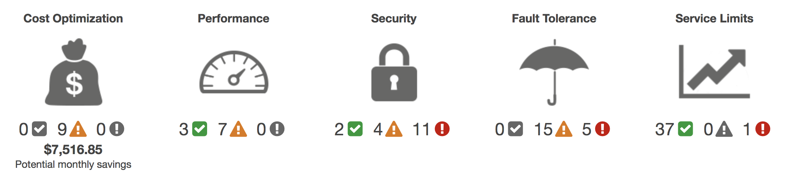
AWS Trusted Advisor
AWS Trusted Advisor provides recommendations that help you follow AWS best practices.
Trusted Advisor evaluates your account by using checks. These checks identify ways to optimize your AWS infrastructure, improve security and performance, reduce costs, and monitor service quotas.
AWS Basic Support and AWS Developer Support | Basic 7 Checks
AWS Business Support and AWS Enterprise Support | All Checks

Slide 176

AWS Config

Slide 177
AWS Config
AWS Config continually assesses, audits, and evaluates the configurations and relationships of your resources.
Inventory and configuration management | What is currently out there? What is the latest configuration state of my resources? What relationships exist between my resources? What configuration changes occurred in the past? Which resources have violated compliance policies?
Governance and compliance management | Are my resources properly configured? Do my resources comply with regulatory requirements How do I ensure continuous compliance? How can I get notified in near real-time if resource(s) go out of compliance?

Slide 178





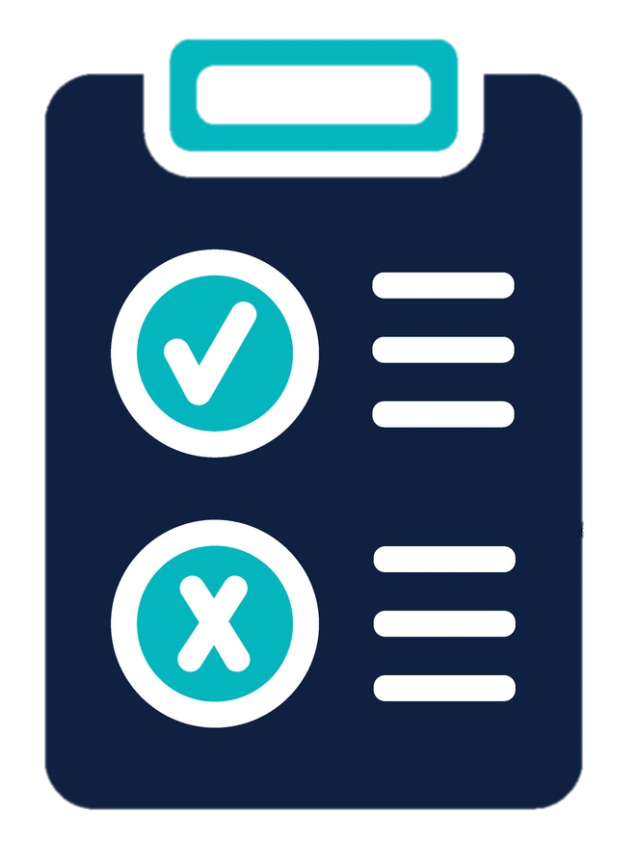



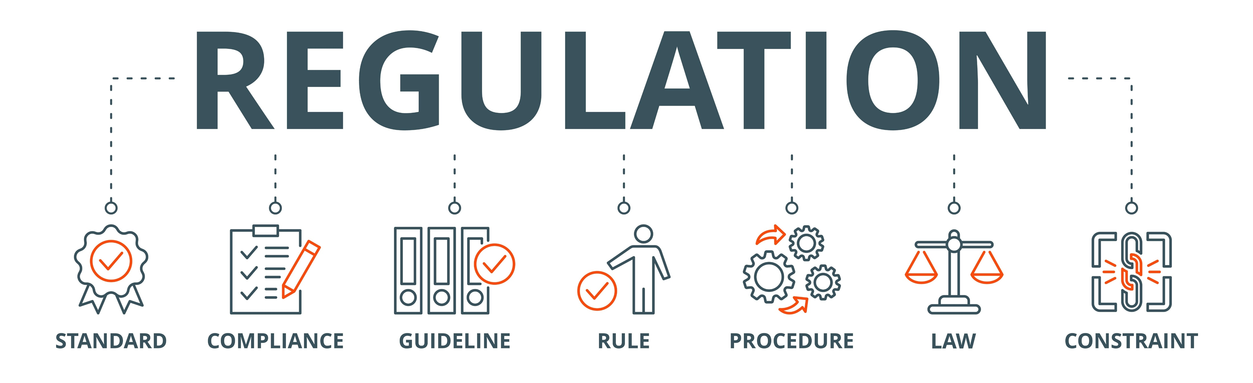


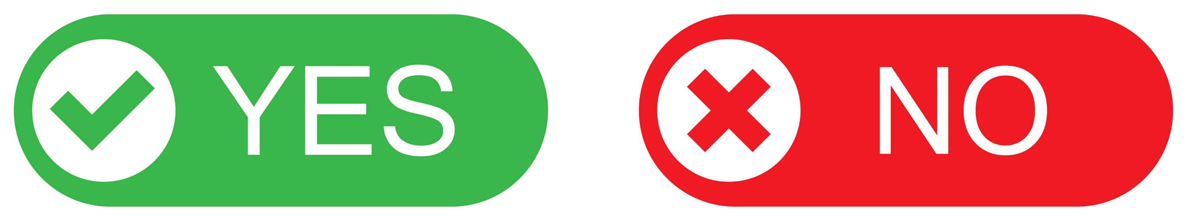
AWS Config - Track Resource Inventory and Changes
Changes in resources
Configuration
Item (CI)
History, Snapshot
Query
AWS Config
Rules
Timeline
AWS Managed Rules
Custom Rules
Conformance Packs
Compliant?
Dashboard
Automated
Remediation

Slide 179
AWS Config – Features (1)
Configuration history of AWS resources
Records details of changes to your AWS resources to provide you with a configuration history timeline
Obtain details of what a resource’s configuration looked like at any point in the past
Configuration history of software (requires SSM agent)
Records software configuration changes within your Amazon EC2 instances and servers running on-premises or other cloud providers
Provides a history of OS and system-level configuration changes alongside infrastructure configuration changes recorded for EC2 instances
Configuration snapshots
Provides a point-in-time capture of all your resources and their configurations

Slide 180
AWS Config – Features (2)
Configurable and customizable rules
Assess your resource configurations and resource changes for compliance against built-in or custom rules and automate remediation of non-compliant resources
Customize pre-built rules or create your own custom rules in AWS Lambda that define your internal best practices and guidelines for resource configurations
Resource relationship tracking
Discovers, maps, and tracks AWS resource relationships in your account
For example, if a new Amazon EC2 security group is associated with an Amazon EC2 instance, Config records the updated configurations of both the Amazon EC2 security group and the Amazon EC2 instance.

Slide 181
AWS Config – Features (3)
Conformance packs
Packages a collection of AWS Config rules and remediation actions into a single entity and deploy it in a single account or across an entire organization.
Multi-account, multi-region data aggregation
Enables centralized auditing and governance by providing an enterprise-wide view of your resources and Config rule compliance status
Cloud governance dashboard
Provides a visual dashboard to help you quickly spot non-compliant resources and take appropriate action

Slide 182

AWS Network Firewall

Slide 183











AWS Network Firewall
Internet
Region 1
VPC (10.0.0.0/16)
AZ a
AZ b
Internet gateway
VPN
connection
Public subnet
10.0.1.0/24
Public subnet
10.0.2.0/24
SG
Internet Route Table
10.0.0.0/16 – Local
SG
NACL
NACL
On Prem
Network
A
0.0.0.0/0 – IGW
B
NAT gateway
Private subnet
10.0.11.0/24
Private subnet
10.0.12.0/24
Virtual Private Gateway (VGW)
Direct Connect (DX)
AWS
Network
Firewall
SG
Main Route Table
10.0.0.0/16 – Local
SG
NACL
NACL
Region 2
C
0.0.0.0/0 – NAT
D
VPC
NACL
SG
VPC Peering
connection
E
Outbound to Internet
Inbound from Internet
AWS Direct Connect and VPN
VPC-to-VPC traffic

Slide 184





With and Without AWS Network Firewall
Without
Network Firewall
VPC (10.0.0.0/16)
Your Subnet
Internet
Internet gateway
Internet Route Table
10.0.0.0/16 – Local
0.0.0.0/0 – IGW
With
Network Firewall
AWS Network Firewall Service
Amazon S3
Amazon CloudWatch Logs
Policy
Logging
Amazon Kinesis Data Firehose
VPC (10.0.0.0/16)
Firewall Subnet
10.0.1.0/28
Internet
Your Subnet
10.0.0.0/24
Firewall Endpoints
Internet gateway
Internet Route Table
10.0.0.0/16 – Local
Firewall Route Table
10.0.0.0/16 – Local
IGW Route Table
10.0.0.0/16 – Local
0.0.0.0/0 – FW-EP
0.0.0.0/0 – IGW
10.0.0.0/24 – FW-EP

Slide 185
AWS Network Firewall
There are 3 key components of AWS Network Firewall.
Rule Groups
Holds a reusable collection of criteria for inspecting traffic and for handling packets and traffic flows that match the inspection criteria.
Policy
Defines a reusable set of stateless and stateful rule groups, along with some policy-level behavior settings.
Firewall
Enforces the inspection rules in the firewall policy to the VPC that the rules protect. Each firewall requires one firewall policy. The firewall additionally defines settings like how to log information about your network traffic and the firewall's stateful traffic filtering.

Slide 186
AWS Network Firewall - Walkthrough
AWS Network Firewall Service
Policy
Logging
VPC (10.0.0.0/16)
Firewall Subnet
10.0.1.0/28
Internet
Your Subnet
10.0.0.0/24
Firewall Endpoints
Internet gateway
Internet Route Table
10.0.0.0/16 – Local
Firewall Route Table
10.0.0.0/16 – Local
IGW Route Table
10.0.0.0/16 – Local
0.0.0.0/0 – FW-EP
0.0.0.0/0 – IGW
10.0.0.0/24 – FW-EP

